Slide 1
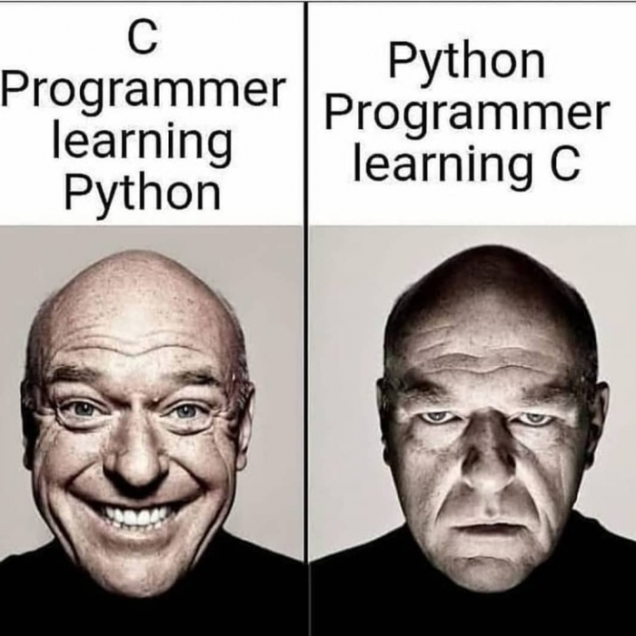
Python-palooza
Our objective:
Understand Python well enough to write moderately complex programs and read code

Slide 2

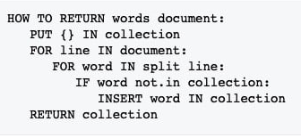

A Brief History of Python
It's Christmas break of '89, and Guido van Rossum was looking for something to keep him occupied.
So, of course, he decided to invent a new programming language!
Guido had already contributed to the ABC language – which he liked – so he based his new language on ABC.
"In February 1991, after just over a year of development, I decided to post to USENET."
And instantly, was a thing!!

Slide 3

But Why Name it 'Python'?
Guido needed a name for his language! But what?
He was a big fan of Monty Python's Flying Circus – a BBC comedy show...
So... he named it 'Python,' of course!

Slide 4







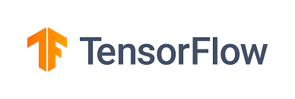
Python Uses
Quick & Dirty Scripting
Industrial Scripts
Web Backends
Data Science
Machine Learning

Slide 5


Avoid Python For...
Writing efficient programs – most versions are interpreted, after all!
performance
But... Python does have the ability to plug-in modules from other languages like C++ to optimize key operations!
That's how modules like PyTorch, TensorFlow and NumPy execute so quickly!

Slide 6
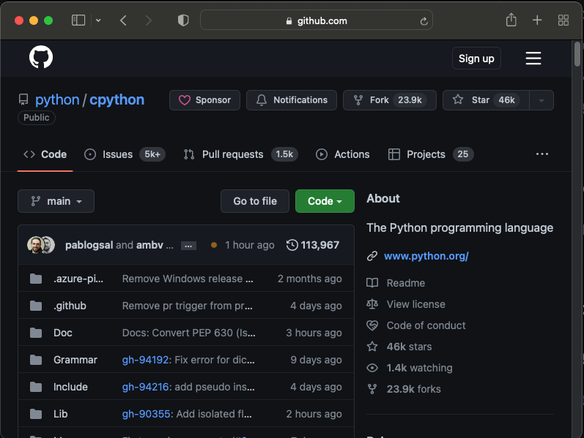
Python: An Open Source Language!
Want to see the Python interpreter source code?
https://github.com/python/cpython
The interpreter and libraries are written in plain old C!

Slide 7
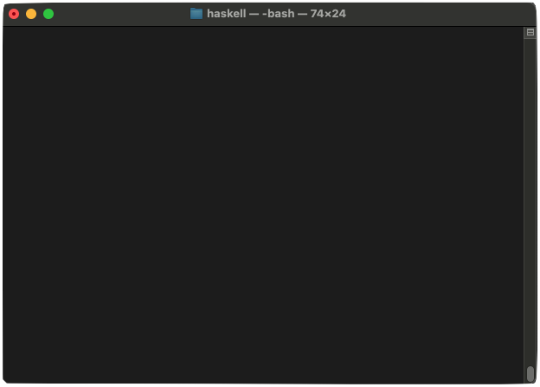
The Python Shell
The Python interpreter is officially called the Python Shell.
This indicates that we're in the middle of a multi-line input
It can be used interactively ...
python3
climberkip$
Python 3.9.6
<a bunch more boilerplate removed for clarity>
>>>
def f(x,y):
...
print(f'{x} + {y} is {x+y}')
...
Hitting enter ends multi-line input.
>>>
f(10,20)
We can then call functions interactively!
10 + 20 is 30
>>>
bar = 10
>>>
bar/3+5
8.3333333333333334
>>>
^D
To exit the shell, hit Ctrl-D on a line by itself or type quit().

Slide 8
The Python Shell
The Python interpreter is officially called the Python Shell.
It can be used interactively ...
Or used to run programs saved in .py files.
python3 hello.py
climberkip$
hello.py
Hello world!
Have a nice day!
# Python hello world – this is a comment
print('Hello world!')
print('Have a nice day!')
climberkip$

Slide 9





A Basic Intro to Python (Through Challenges)
Next, I'm going to give you a bunch of Python challenge problems.
Your job is to reason through the unfamiliar syntax and semantics and try to figure out what's going on...
Use google, the Python shell or discuss with your neighbor!
Expect to get many/most of these wrong – that's not only OK, it's critical for learning!!!

Slide 10
Program Execution
lets_go(person):
print('Hey, ' + person)
print("Let's go to Del Taco!")
Challenge: What can we infer about the flow of execution in Python based on the following program and its output?
main():
print('Oh crap, now I have gas!')
Thinking time!
The Python interpreter runs each file from top-to-bottom - if it sees a statement, it runs it! There is no default main() function that runs!
deltaco.py
def lets_go(person):
print('Hey, ' + person)
print("Let's go to Del Taco!")
lets_go('Carey')
def main():
print('Oh crap, now I have gas!')
print('Nom nom')
python3 deltaco.py
climberkip$
Hey, Carey
Let's go to Del Taco!
This def command defines a new function – the command is interpreted like any other statement!
Nom nom
This defines our second function.
When interpreted, this calls our just-defined function!
Note that just defining a function, like main(), doesn't cause it to be called!
Notes:
Unlike many other languages, there's technically no required main() function required in Python!
Why? The Python interpreter just runs each file from top-to-bottom - if it sees a statement, it runs it!
It's customary to have a main function(), but you have to call it explicitly to make it run! It won't just run because you've defined it.

Slide 11
Program Execution
That said, it IS conventional to have a function called main() in a Python program.
Any time you launch a Python script from the command line.
Let's verify that assumption!
Here's how to do so in a Pythonic way.
So it sets a special variable __name__ to "__main__" – telling us that we should run our main function.
__name__
"__main__"
First we define all of our other functions/classes...
deltaco.py
def lets_go(to):
print('Hey, ' + to)
print("Let's go to Del Taco!")
def finish_food():
print('Oh crap, now I have gas!')
def main():
lets_go('Carey')
print('Nom nom')
finish_food()
if __name__ == "__main__":
main()
python3 deltaco.py
climberkip$
Python assumes we want to run the script's main() function.
Hey, Carey
Let's go to Del Taco!
Nom nom
climberkip$
Oh crap, now I have gas!
Then we define our main function.
But just defining it won't make it run!
As expected – the main function didn't run!
So we have to add one more piece of "magic" to the end of the file.
We can check this variable's value and if it's set to __main__, run our main() function.

Slide 12
Functions
What interesting things do you notice about how these functions accept parameters and return values?
Nor do you specify a return type for functions!
You don't specify the types of your parameters!
Thinking time!
def good_morning():
print('Top of the morning to you!')
def smoosh(x, y):
return x + y
def congrats(occasion, who='my friend'):
message = f'Happy {occasion}, {who}!'
return message
good_morning()
print(smoosh(5,20))
print(smoosh(10,y=20))
print(congrats('birthday'))
print(congrats(who='Sachi', occasion='weekend'))
Python lets you specify default values for parameters!
Top of the morning to you
25
30
Happy birthday, my friend!
Happy weekend, Sachi!
The default value is used if you don't pass a value for the parameter.
You can explicitly specify parameter names when calling functions!

Slide 13
Variables and Types
Challenge: What can we infer about how Python handles variables and parameters from this code?
Thinking time!
While every variable has a fixed type in C++...
We don't need to define a variable before using it!
Python variables have no type – just a name!
def add_n_print(x, y):
print(x + y)
def main():
a = 10
b = 20
add_n_print(a, b)
a = 'I <3 '
b = 'coding'
add_n_print(a, b)
We can re-assign variables to values of different types over time!
// C++
int main() {
int a = 10;
...
}
To define a variable, we simply assign it a value!
Only the value currently associated with the variable name has a type!
The same function can operate on values of different types!
As long as an operator is compatible with its operands, it works!
You don't specify a type for each variable!

Slide 14



Variables and Types
Academic Robot Says:
"This approach is called
'dynamic typing' – the language only checks the types of operands the moment an operation occurs."
Challenge: The code below generates an error.
Will it generate the error before the program runs, or as it runs on line #1, or on line #2?
Thinking time!
def add_n_print(x, y):
print(x + y) # Line 1
def main():
add_n_print('foo', 5) # Line 2
TypeError: can only concatenate str (not "int") to str
Sarcastic Robot Says:
Answer: This code generates an error when the code reaches line #1 at runtime.
"This makes it REALLY difficult to find Python bugs quickly.
In contrast, 'statically typed' languages like C++ find these bugs at compile time!"
Python's runtime type-checker detects that the types of values that a and b refer to are incompatible, and generates an error as the operation is performed.

Slide 15
More Variables and Types
Academic Robot Says:
"These are considered a best-practice in industry!
Most companies use tools to check for issues and block code submission!"
Challenge: This program uses Python type hints (introduced in Python 3.5) to specify types for variables/parameters.
Will the program below generate an error?
Thinking time!
def make_bday_msg(name: str, age: int) -> str:
msg: str = f'Happy {age}th birthday, {name}!'
return msg
say_this: str = make_bday_msg(3.14159, 'hamsters')
print(say_this)
Answer: This code runs just fine, and prints:
Happy hamstersth birthday, 3.14159!
Python's type hints are NEVER enforced by the Python interpreter!
They're intended to help 3rd-party code checking tools to identify bugs!

Slide 16
Variables and Scope
Challenge: Will the trick_or_treat() function generate an error, or will it work?
In Python, once you define a variable, it stays in scope until the function ends!
Thinking time!
In contrast, in C++ variables go out of scope...
void trick_or_treat(string name, int age) {
if (age < 10) {
string goodie = "candy corn";
cout << "Boooooo!";
} else {
string goodie = "Snickers";
cout << "Bwahahahahaha!";
}
cout << name << ", here's your " << goodie << "!\n";
}
def trick_or_treat(name, age):
if age < 10:
goodie = 'candy corn'
print('Boooooo!')
else:
goodie = 'Snickers'
print('Bwahahahahaha!')
print(f"{name}, here's your {goodie}!")
trick_or_treat('Felix', 5)
goodie
'candy corn'
It'll work! Let's see!
So even though the block ends...
At the end of the block where they're defined!
Our variable doesn't go out of scope!
error: use of undeclared identifier 'goodie'
Boooooo!
Felix, here's your candy corn!
Notes:
error: use of undeclared identifier 'goodie'

Slide 17
Looping With Counters
So i takes on the values of 2, 3 and 4.
range returns a sequence of integers between [x,y).
Challenge: What does the following program print?
for i in range(2,5):
print(f'{i} witches!')
for i in range(7,1,-2):
print(f'{i} zombies!')
goblins = 100
while goblins > 0:
if goblins % 97 == 0 or goblins < 62:
break
print('Boo!')
goblins -= 1
print('That was scary!')
Goes from [A,B) advancing by C each iteration.
Thinking time!
2 witches!
3 witches!
4 witches!
7 zombies!
5 zombies!
3 zombies!
Boo!
Boo!
Boo!
That was scary!
Python's while loop works just like you'd expect!
break immediately terminates the loop.

Slide 18
Language Of The Week: APL
This function is launched on thousands of GPU cores.
// OpenCL ”kernel” module (runs on GPU)
__kernel void matrixAdd(
__global const float* matA,
__global const float* matB,
__global float* matC,
const int numRows, const int numCols) {
// Assuming matrices are n by m cells,
// cellNum ranges from 0 to n*m - 1
const int cellNum = get_global_id(0);
// Fetch the same cell from matrices
// A and B, add them, and store in C
if (cellNum < numRows * numCols)
matC[cellNum] = matA[cellNum] +
matB[cellNum];
}
History
Based on C, OpenCL was released by Apple, Nvidia and others in 2008 to simplify parallel programming of GPU chips.
Each instance of the function that executes is asked to add a different cell of the two matrices.
Programming Language of The Week
Overview
The programmer writes an OpenCL module which is executed in parallel on 1000s of GPU cores. Each module instance uses a ”global id” to determine what subset of the task it’s supposed to work on.
Here we add a single cell from the two input matrices and store the results in the output matrix C.
Unique Aspects
Impact
OpenCL is hardware-agnostic, so a module can work seamlessly across GPUs from many different vendors without modification.
Has impacted fields such as scientific research, machine learning, and high-performance computing.
Notes:
Developed by Apple, AMD, Nvidia and others, OpenCL was released in 2008 to simplify parallel programming of a diverse set of GPU accelerator chips.

Slide 19
Classes
Here's a class definition...
In Python, the constructor is always called __init__ - that 's _ _ init _ _.
In Python, the first parameter of each method must be "self" – it's like "this" in C++.
class Car:
MILES_PER_GAL = 30
def __init__(self, gallons):
self.gas_gallons = gallons
self.odometer = 0
def drive(self, miles):
gals_needed = miles / Car.MILES_PER_GAL
if self.gas_gallons > gals_needed:
self.gas_gallons -= gals_needed
self.odometer += miles
def get_odometer(self):
return self.odometer
Let's learn about Python classes – they're quite different from those in C++.
Instead, to create a member variable named foo, you simply write:
self.foo = value
How do you define a constructor in a Python class?
How do you define member variables in a Python class?
In Python, there's no way to declare a class's member variables without assigning them (like we do in C++).
How is a method different from a normal Python function?
class Car {
public:
...
private:
double gas_gallons, odometer;
};
Here's how we instantiate and use an object of our class.
The constructor is called when you define a new object, like this.
def use_car():
c1 = Car(16) # 16 gallons of gas
c1.drive(10)
print(f'I drove {c1.get_odometer()} mi')
Thinking time!
Normal functions have no "self" parameter.
Notes:
From Guido:
"Normally, a function definition is an executable statement that simply sets a variable in the current namespace referencing the function object (the variable name is the function name). Thus, rather than coming up with an entirely different approach for handling classes, it made sense to me to simply interpret the class body as a series of statements that were executed in a new namespace. The dictionary of this namespace would then be captured and used to initialize the class dictionary and create a class object. Underneath the covers, the specific approach taken is to turn the class body into an anonymous function that executes all of the statements in the class body and then returns the resulting dictionary of local variables. This dictionary is then passed to a helper function that creates a class object. Finally, this class object is then stored in a variable in the surrounding scope, whose name is the class name. Users are often surprised to learn that any sequence of valid Python statements can appear in a class body. This capability was really just a straightforward extension of my desire to keep the syntax simple as well as not artificially limiting what might possibly be useful.
A final detail is the class instantiation (instance creation) syntax. Many languages, like C++ and Java, use a special operator, “new”, to create new class instances. In C++ this may be defensible since class names have a rather special status in the parser, but in Python this is not the case. I quickly realized that, since Python’s parser doesn’t care what kind of object you call, making the class object itself callable was the right, “minimal” solution, requiring no new syntax. I may have been ahead of my time here---today, factory functions are often the preferred pattern for instance creation, and what I had done was simply to turn each class into its own factory."

Slide 20
Classes
Academic Robot Says:
"The definition of a Python class is just a sequence of statements like a regular Python program!
In fact, you can include any legal Python code in your class definition."
class Car:
print('I like traffic lights')
def drive(self,miles):
print(f'I drove {miles} miles!')
print ("As long as they're green")
class Car:
MILES_PER_GAL = 30
def __init__(self, gallons):
self.gas_gallons = gallons
self.odometer = 0
def drive(self, miles):
gals_needed = miles / Car.MILES_PER_GAL
if self.gas_gallons > gals_needed:
self.gas_gallons -= gals_needed
def get_odometer(self):
return self.odometer
If I change get_odometer() to:
def get_odometer(self):
return odometer
the code won't work. Why?
How do you call a method from another method?
If you prefix a method with two underscores, this makes it private.
self.odometer += miles
self.__update_odometer(miles)
A method calls another method by using the "self." prefix:
result = self.method(p1,p2,p3)
How do we indicate whether a method is public or private?
def __update_odometer(self, miles):
self.odometer += miles
Let's add one more method!
All other methods are public by default.
If we remove the "self." prefix, this no longer accesses the member variable! It now refers to a (nonexistent) local variable.
def use_car():
c1 = Car(16) # 16 gallons of gas
c1.drive(10)
print(f'I drove {c1.get_odometer()} mi')
Thinking time!
Notes:
Private methods are hidden through the process of name mangling. But if you know how python mangles a function name you can call it externally!

Slide 21
Consider a Circle class, with versions shown in both C++ and Python...
Consider a Circle class, with versions shown in both C++ and Python...
Allocation of Objects
#include <cmath>
class Circle {
public:
Circle(double rad)
{ this->rad = rad; }
double area() const
{ return M_PI * rad * rad; }
void setRadius(double rad)
{ this->rad = rad; }
private:
double rad;
};
import math
class Circle:
def __init__(self, rad):
self.rad = rad
def area(self):
return math.pi * self.rad**2
def set_radius(self, rad):
self.rad = rad
C++ gives us two ways to instantiate an object.
And here's how we define an object in Python.
Circle c(10);
cout << c.area();
Circle *p = new Circle(20);
cout << p->area();
We can define a local object on the stack...
c = Circle(10)
print(c.area())
Or we can allocate the object on the heap.

Slide 22
Allocation of Objects
Challenge: How does Python allocate objects? Is it A or B?
Here's a hint!
Answer: Python uses approach B – it doesn't have pointers, but it does have a similar concept called object references.
Thinking time!
and sets our pointer variable to point to the new object.
We then use the -> operator to call methods through our pointer.
We then use the dot operator to call methods on our object.
And then pointed to by an object reference.
Approach A
Approach B
We use the dot operator with object references to call methods.
Every Python object is allocated on the heap...
c
This allocates a local variable on the stack.
rad
This first creates a pointer to point at our new object.
rad
10
10
rad
20
p
c
Circle c(10);
cout << c.area();
Circle *p = new Circle(20);
cout << p->area();
c = Circle(10)
print(c.area())
Then it allocates the object on the heap...
# how does this work?
c = None # Hint: None is like nullptr

Slide 23
Allocation of Objects
Sarcastic Robot Says:
"Wow, Python uses object references even for integers, floats and strings?!?!?
That's quite inefficient!!!"
that point to an integer value sitting in heap memory!
Believe it or not, in Python, ALL variables are object references!
Even simple integer variables are really object references...
(Not just variables that refer to class objects)
But for our purposes, you can ignore this for primitives (e.g., ints, strings).
For primitives, you can visualize it this way.
i
i
-10
42
Approach A
Approach B
-10
While this is what's really going on...
c
rad
10
rad
20
rad
10
p
c
c = Circle(10)
print(c.area())
# how does this work?
i = 42
i = -10

Slide 24
The Construction Process
This statement dynamically creates a new member variable and assigns its value!
The self parameter points at our newly-reserved block of RAM that holds our object.
# Circle class in Python
import math
class Circle:
def __init__(self, rad):
self.rad = rad
if rad > 10**100:
self.really_big_circle = True
def area(self):
return math.pi * self.rad**2
def set_radius(self, rad):
self.rad = rad
# Circle class in Python
import math
class Circle:
def __init__(self, rad):
self.rad = rad
def area(self):
return math.pi * self.rad**2
def set_radius(self, rad):
self.rad = rad
OK, now let's see the whole construction process.
rad
10
self
Before our constructor runs, Python allocates RAM for an new Circle object.
This member variable will only exist in Circle objects that are really big!
Finally, we assign the variable (object reference) so it points to the object.
Notice it has no member variables defined!
10
rad
c = Circle(10)
print(c.area())
c

Slide 25
Calling a Method
# Circle class in Python
import math
class Circle:
def __init__(self, rad):
self.rad = rad
def area(self):
return math.pi * self.rad**2
def set_radius(self, rad):
self.rad = rad
Now let's see how a method call works.
So the self parameter always refers to the item that's left of the dot, e.g., c.area()
self
When we call a method, Python passes the object reference to the self parameter!
rad
10
c = Circle(10)
print(c.area())
10
c

Slide 26
Class Variables
When you define a class, Python creates a special "class" object that holds the class's details.
This defines a class member variable. Its value is associated with the overall class.
There's only one copy of this variable, and it's associated with the overall class.
thing.py
When we use the self. prefix to set a variable, this creates a member variable in the object.
Thing class
When we use the class's name as a prefix to access a variable (e.g., Thing.), this refers to the overall class variable.
class Thing:
thing_count = 0
def __init__(self, v):
self.value = v
Thing.thing_count += 1 self.thing_num = Thing.thing_count
thing_count
2
1
0
__init__(self, v)
Challenge: What does the following program print? Why?
# method code...
But this refers to our class member variable.
Thinking time!
1 1
1 2
2 2
1 1
1 2
2 2
from thing import Thing
t1 = Thing("a") print(f"{t1.thing_num} {Thing.thing_count}")
t2 = Thing("b")
print(f"{t1.thing_num} {Thing.thing_count}")
print(f"{t2.thing_num} {Thing.thing_count}")
The class object only holds information about the overall Thing class, NOT individual Thing objects.
But this refers to our class member variable.
This refers to our object's member variable.
But this refers to our class member variable.
This refers to our object's member variable.
Let's see why!
Notice that our object does NOT have a thing_count member variable!
This refers to our object's member variable.
Only use a class variable when you need a variable whose value is shared across all of your object instances.
value
"a"
value
"b"
t1
thing_num
t2
thing_num
1
2

Slide 27
Class Variables
Class Methods
thing.py
class Thing:
thing_count = 0
def __init__(self, v):
self.value = v
Thing.thing_count += 1 self.thing_num = Thing.thing_count
A class method is a method that has no self parameter. As such...
class Thing:
thing_count = 0
def __init__(self, v):
self.value = v
Thing.thing_count += 1 self.thing_num = Thing.thing_count
def change_val(self, new_val):
self.value = new_val
def a_class_method(foo, bar):
return Thing.thing_count * foo + bar
def another_class_method(bletch):
Thing.a_class_method(bletch,20)
As such...
it can't access member variables
Notice they don't have a self parameter!
it can't call instance methods
Since class methods don't have a self parameter...
Since class methods don't have a self parameter...
So what can they do?
These are examples of class methods.
from thing import Thing
t1 = Thing("a") print(f"{t1.thing_num} {Thing.thing_count}")
t2 = Thing("b")
print(f"{t1.thing_num} {Thing.thing_count}")
print(f"{t2.thing_num} {Thing.thing_count}")
They can......
access class variables
call other class methods
self.change_val(bar) # ERROR!
print(self.value) # ERROR!
To call a class method, use this syntax:
class_name.method_name(params)
They can't access member variables like self.value!
They can't call instance methods like change_val!
from thing import Thing
t1 = Thing("a") Thing.another_class_method(42)
Use class methods when the only state that needs to be operated on is class variables, or the method does not need any not state.

Slide 28
Copying of Objects
# Circle class in Python
import math
class Circle:
def __init__(self, rad):
self.rad = rad
def area(self):
return math.pi * self.rad**2
def set_radius(self, rad):
self.rad = rad
Moral of the story:
Assignment of object references (e.g., c2 = c) does NOT make a copy of the object like in C++!
Challenge: What happens when we run the following code?
Let's see!
Thinking time!
To make a distinct copy of an object, you need to use a special copying method!
So now we have two object references pointing to the same object!
This creates a new object reference called c2...
So this change affects the object pointed to by both object references!
rad
0
c = Circle(10)
print(c.area())
10
c
c2
c2 = c
c.set_radius(0)
print(c2.area()) # What happens?!?!?
This takes c's object reference and copies it into c2.
# prints 0

Slide 29
Copying of Objects
Python has deep copying:
# Circle class in Python
import math
class Circle:
def __init__(self, rad):
self.rad = rad
def area(self):
return math.pi * self.rad**2
def set_radius(self, rad):
self.rad = rad
A deep copy makes a copy of the top-level object and every object referred to directly or indirectly by the top-level object:
y = copy.deepcopy(x)
Let's see how to make a copy of an object.
Now changes to either object are isolated from the other!
x
y
1
2
1
2
4
5
4
5
Python has shallow copying:
A shallow copy just makes a copy of the top level object:
y = copy.copy(x)
import copy
c = Circle(10)
print(c.area())
rad
x
rad
0
10
c = Circle(10)
print(c.area())
10
c
1
2
c2
4
5
c2 = copy.deepcopy(c)
y
c.set_radius(0)

Slide 30


Python: Automatic Garbage Collection
It becomes a candidate for garbage collection.
In Python, you don't have to worry about freeing objects when you're done with them, like you have to in C++!
Why? Python automatically tracks each object and deletes it when your program no longer refers to it!
As with C++, Python allocates objects in heap memory.
title
'Watersh...
// C++ has manual memory management!
void study() {
Book *b = new Book("Watership Down");
b->read();
delete b; // Explicitly free when done!
}
void go_to_ucla() {
study();
}
# Python has automatic mem. mgmt.
def study():
b = Book("Watership Down")
b.read()
# nothing to do!
def go_to_ucla():
study()
b
As long as some variable refers to an object, the object is kept around.
But when the last reference to the object goes away...

Slide 31
Classes and Destructors
Academic Robot Says:
In garbage collected languages we use a destructor to free non-memory resources - like deleting temporary files, or closing network connections...
But, since the destructor may never be called, it's best to define your own disposal() function and explicitly call it when necessary.
Ok – what about destructors in Python?
Python classes may have destructors – but they're rarely used, and NOT guaranteed to run!
In Python, the garbage collector does this for us!
// Destructors in C++
class TextBook
{ ... };
class Student {
public:
Student() { my_book_ = new TextBook(); }
void study() { my_book_->read(); }
private:
TextBook *my_book_;
};
# Destructors in Python
class TextBook:
...
class Student:
def __init__(self):
self.book = TextBook()
def study(self):
self.book.read()
If so, during garbage collection, the destructor will be called automatically.
Python's destructor is named __del__ - that's _ _ del _ _.
So our destructor doesn't need to worry about it!
While we have to explicitly free allocated objects in C++...
~Student() {
if (my_book_->finished_reading())
cout << "You graduated!";
delete my_book_;
}
def __del__(self):
if self.book.finished_reading():
print("You graduated!")
When an object is no longer referred to by an object reference, it may be garbage collected.
def go_to_school():
irman = Student()
irman.study()
return

Slide 32
It simply WON'T be called! 😂
Inheritance
class Person:
def __init__(self, name):
self.name = name
def talk(self):
print('Hi!\n')
class Student(Person):
def __init__(self, name):
super().__init__(name)
self.units = 0
def talk(self):
print(f"Heya, I'm {self.name}.")
print("Let's party! Oh... and ")
super().talk()
This is how we show a derived class is inherited from a base class.
OK, so what about inheritance?
How does a derived class inherit from a base class?
If you forget to call to the base's constructor...
Methods are virtual by default in Python – you may re-define any method in the derived class.
Don't forget to have the derived constructor explicitly call the base class constructor!
How does a derived class method override a base class method?
When you call a method, Python automagically figures out the right one for the object!
How does a derived method call a base-class method?
A derived class method can call any base class method via the super() prefix!
def chat(p):
p.talk()
def cs131_lecture():
s = Student('Angelina')
chat(s)
Thinking time!
Notes:
https://docs.python.org/3.6/reference/datamodel.html#object.__del__
If a base class has a __del__() method, the derived class’s __del__() method, if any, must explicitly call it to ensure proper deletion of the base class part of the instance.

Slide 33
Duck Typing
class PersonInDuckSuit:
... # code omitted for clarity
def quack(self):
print('Hi! Err... oops, I mean quack quack.')
class Duck:
... # code omitted for clarity
def quack(self):
print('Quack quack quack!')
class Vehicle:
... # code omitted for clarity
def drive(self):
print('Vrooooom!')
Academic Robot Says:
If so, the quack() method is called.
Notice that these classes don't even use inheritance or polymorphism!
Consider the following three classes and the code below which uses them.
What does this program print?
If an object doesn't have a quack() method, Python generates an error.
Thinking time!
def quack_please(x):
x.quack()
p = PersonInDuckSuit()
d = Duck()
v = Vehicle()
quack_please(p)
quack_please(d)
quack_please(v)
When this line of code runs, Python checks if the object referred to by x has a quack() method...
Hi! Err... oops, I mean quack quack.
Quack quack quack!
AttributeError: 'Vehicle' object has no attribute 'quack'
This is called "duck typing" – in Python, if an object has the requested method, a call to it will just work.
"If it quacks like a duck, then it must be a duck."

Slide 34
Object Equality In Python
In this case, a and b refer to two different objects in memory.
In this case, both a and c refer to the same Circle object – so "c is a" is a true condition.
Even though a and b refer to different objects, those objects have the same value.
Challenge: What does the following program print?
Thinking time!
# Different types of equality in Python
fav = 'pizza'
a = f'I <3 {fav}!'
b = f'I <3 {fav}!'
c = a
if a == b:
print('Both objects have same value!')
if c is a:
print('c and a refer to the same obj')
if a is not b:
print('a and b refer to diff. objs')
a
'I <3 pizza!'
The == operator tests for equality of value.
c
The "is" operator tests if two object references refer to the same exact object in memory.
b
'I <3 pizza!'
"is not" tests if two object references refer to different objects in memory.
fav
'pizza'
Both objects have same value!
c and a refer to the same obj
a and b refer to diff. objs
Notes:
Python has different notions of object equality:
Do two objects have the same logical value (e.g., two circle objects with the same radius)
Are two variables (object references) referring to the same exact object in memory
You use different operators to test for each of these conditions.

Slide 35
Object Identity In Python
It refers to the same object that a does, so the id number is the same!
Every distinct object has a unique ID number or "identity" in Python – you can ask for this with the id() function. Let's see!
Even though c is a different object reference...
# Different types of equality in Python
fav = 'pizza'
a = f'I <3 {fav}!'
b = f'I <3 {fav}!'
c = a
if a == b:
print('Both objects have same value!')
if c is a:
print('c and a refer to the same obj')
if a is not b:
print('a and b refer to diff. objs')
# Different types of equality in Python
fav = 'pizza'
a = f'I <3 {fav}!'
b = f'I <3 {fav}!'
c = a
print(id(a))
print(id(b))
print(id(c))
a
'I <3 pizza!'
This says the id number of the object referred to by a is 140426129935136.
c
b
'I <3 pizza!'
fav
'pizza'
140426129935136
140426129649376
This object has its own distinct id number, as expected.
140426129935136
Notes:
You can think of id(x) as the same as &x in C++. It's essentially giving you the address of the object.

Slide 36
Object Identity In Python
Sarcastic Robot Says:
'Carey, this is all academic because it's transparent to the programmer.'
This gives us the ID of the object/value currently pointed to by booger.
Challenge: Will the two printed IDs differ or be the same?
Then Python reassigns the booger object reference to hold the new value's address!
And the same thing happens with this code too!
Thinking time!
# Each object has a unique ID in Python
booger = 10
print(id(booger))
booger = booger + 1
print(id(booger))
The location of the variable's value doesn't change just because you update its value.
In C++, local variables are directly bound to a fixed storage cell in RAM.
booger
10
booger += 1 # also has different IDs!
11
1000
1004
1008
1012
...
// C++ is different!
int main() {
int booger = 10;
cout << &booger << endl;
booger = booger + 1;
cout << &booger << endl;
}
When we run this line, Python creates a new value equal to 10 + 1.
booger
10
11
The two values are separate objects, so they have different IDs!
Academic Robot Says:
140426129935136
140426129649376
'Yeah, it IS transparent, but it's also important for students to understand the semantics of the language!'
1004
Answer: They differ, because the two values are two separate Python objects!
1004

Slide 37
None?
Challenge: What is the purpose of Python's None keyword?
In Python, False is NOT the same as None!
Thinking time!
But you can use the "not" keyword to check for None!
q = None
if q is False:
print('Is None the same as False?')
if not q:
print('Does not work with None?')
if q is None:
print('Ahhh q is None!')
if q == None:
print('Ahh q == None!')
def play_with_dog(lst):
obj = None
for x in lst:
if x.is_canine():
obj = x
break
if obj is not None:
obj.give_bone()
Setting a variable to None is like setting a C++ pointer to nullptr.
Challenge: What will the program on the left print?
This is the Pythonic (preferred) way of seeing if an object reference does not refer to None!
Thinking time!
def declare_happiness(what=None):
if what is None:
print("I'm happy for no reason!")
else:
print(f'{what} makes me happy!')
This is the Pythonic way of seeing if an object reference refers to None!
Does not work with None?
Ahh q is None!
Ahh q == None!
Notes:
None is not really like nullptr. None is actually a "singleton" object that represents "nothing". By singleton, we mean that there's only one None object in a python program. So:
a = None
b = None
Above, both a and b refer to the same None object!

Slide 38
Strings
Remember: Every variable in Python is an object reference...
That refers to an object.
In Python, each string is an object just like our Circle objects!
Strings are immutable, meaning they can't be modified once created.
fact1
'Del Taco rules! '
'Del Taco rules! CS131 is lit! I have spoken.'
fact2
'CS131 is lit! '
At some later time, our original string is garbage collected!
truth
'Del Taco rules! CS131 is lit! '
Then it changes the object reference to point at the new object!
fact1 = 'Del Taco rules! '
fact2 = 'CS131 is lit! '
truth = fact1 + fact2
truth += 'I have spoken.'
Challenge: The code to the left appears to mutate the string referred to by truth. What's actually happening?
This line looks like it mutates the object referred to by truth - but in reality, it creates a NEW string object!
Thinking time!
Python generates/trashes lots of objects as your code runs – and you don't even know it!

Slide 39
Strings
Python makes it super-easy to extract substrings!
Challenge: What will the program on the left print?
# String slicing in Python
truth = 'UCLA students are awesome!'
print(truth[6])
print(truth[1:3])
print(truth[:4])
print(truth[22:])
print(truth[-4:-1])
Thinking time!
To extract a substring of length one from slot a, write:
str[a]
00000000001111111111222222
01234567890123456789012345
To slice a substring from slots [a-b), write:
str[a:b]
# t
To slice characters from slots [0-b), write:
str[:b]
Hint: Think about Python ranges, e.g.: range(1,3).
# CL
# UCLA
To slice characters from slots [a-End], write:
str[a:]
# some!
To slice characters relative to the end of the string, use negative indexes, e.g.:
str[-a:-b]
# ome

Slide 40
Lists
Our stuff variable is an object reference that points at our list object!
Like strings, lists are objects in Python – and they support the same operations as strings!
But... unlike strings, lists are mutable!
["It's", 4, 'real', 'USC students', 'are', 'subpar']
Lists can hold multiple different types of values!
[42, False, 'USC students']
["It's", 4, 'real', 'USC students']
["It's", 4, 'real', 'USC students', 'are']
[42, False, 'walnuts']
stuff
This command mutates the current list object's third element!
This command uses slicing to replace the first two items in the list with three new items.
This variable points to successive items in the list as the loop runs.
Then points our object reference at the new list object.
stuff = [42, False, 'walnuts']
stuff[2] = 'USC students'
stuff[0:2] = ["It's", 4, 'real']
stuff.append('are') # or stuff += ['are']
stuff = stuff + ['subpar']
print(stuff[3:])
if 'walnuts' not in stuff:
for s in stuff:
print(s)
Challenge: What will this program print?
We can also search for items with:
a in b, or a not in b
We can append items onto the end of a list.
Or use stuff.pop() to remove and return the last item from a list!
We can use slicing to extract parts of a list.
['USC students', 'are', 'subpar']
But watch out! Assignment creates a whole new list object!
Thinking time!
It's
4
real
USC students
are
subpar
Finally, we can loop through the items of a list with a for loop!

Slide 41
How are Lists Implemented?
Accessing the j^{th} element of a list, e.g., x[j] is super fast!
# Simple list in Python
stuff = ['apple', 7, [True, False]]
Challenge: How do you think lists are implemented in Python?
stuff
'apple'
7
Based on this, what's the big-O of:
Using the "in" and "not in" commands
Accessing list[j] where j is large
Appending one list onto another
True
False
O(n) for a list of size n
O(1)
O(m+n)
Lists are implemented with dynamically-allocated arrays of object references.
Thinking time!

Slide 42
primes
odds
Lists of Lists
7
1
2
3
'carey'
'todd'
'paul'
lol
1
3
5
# Lists of lists (lol) in Python
primes = [1,2,3]
odds = ['carey', 'todd']
lol = [primes, odds]
primes[2] = 7
odds.append('paul')
odds = [1,3,5]
print(lol)
But does NOT affect the original lol list, which still points at our original odds list!
Let's see a list-of-lists example!
Challenge: What will this program print?
This reassigns the odds object reference to refer to a new list...
Thinking time!
[[1, 2, 7], ['carey', 'todd', 'paul']]

Slide 43
Tuples
We can define a tuple explicitly with parentheses...
def get_school_and_scholarship(gpa):
if gpa > 4.2:
return ('UCLA', 0)
else:
return 'USC', 100000
tup = get_school_and_scholarship(4.5)
print(f'You got into {tup[0]} with ${tup[1]}')
skool, dough = get_school_and_scholarship(1.3)
print(f'You got into {skool} with ${dough}')
Python tuples are immutable, ordered groups of items, e.g.,
([1,2,3],False), (1,True,'foo'), etc.
The tup variable refers to the full returned tuple.
We can index the tuple's values...
Or implicitly using commas.
This assigns skool to tuple[0] and dough to tuple[1].
Tuples are commonly used for returning multiple values from a function.
Challenge: What does the following program print?
You got into UCLA with $0
You got into USC with $100000
Thinking time!

Slide 44
Sets
Python has built-in support for the set abstract data type (ADT)!
draining = set()
draining.add('studying')
draining.add('CS131')
draining.add('dating') draining.add('studying')
draining.remove('CS131')
print(draining)
if 'CS131' not in draining:
print('Studying for CS131 is NOT draining!')
# Let's create a set from a list...
dinner = ['salad','soup','steak','soup','pie']
dinner_set = set(dinner)
print(f'Unique foods: {dinner_set}')
The program to the left prints the following output.
Challenge: Do Python sets hold multiple copies of the same value, or a single unique copy?
Challenge: Are Python sets lexicographically ordered?
The set holds a single copy of each unique value.
Unlike C++ sets, Python sets are NOT ordered,
Challenge: Given the above answers, what data structure does Python use for sets?
{'dating', 'studying'}
Studying for CS131 is NOT draining!
Unique foods: {'soup', 'steak', 'pie', 'salad'}
Thinking time!
Notes:
Python sets are implemented with hash tables!

Slide 45
Sets
# Common set operations are supported by Python
adolescence = {10,11,12,13,14,15,16,17,18,19}
moody_ages = {13,14,15,16,17}
pleasant_yrs = adolescence - moody_ages
print(pleasant_yrs)
fruits = {'apple', 'tomato'}
veggies = {'kale', 'tomato'}
healthy = fruits | veggies
print(healthy)
common = fruits & veggies
for fv in common:
print(fv)
Python makes it easy to do things like set differencing, unions and intersection!
The subtraction operator computes the difference between two sets.
The & operator computes the intersection between two sets.
The | operator computes the union between two sets.
We can iterate through sets just like we do lists or strings!
{10, 11, 12, 18, 19}
{'kale', 'tomato', 'apple'}
tomato
Notes:
The set is built upon a hash table.
in/not-in: O(1)
Intersection: The runtime complexity of the set. intersection() method on a set with n elements and a set argument with m elements is O(min(len(n), len(m))) because you need to check for the smaller set whether each of its elements is a member of the larger set.
union: O(len(s)+len(t))
difference of s-t: O(s) because you have to look up each item in s within t, and any items not found in t are kept. We don't need to look up every item in t!

Slide 46
Dictionaries
The dictionary holds a single copy of each unique value.
attrs = {'cs32':'a weeder', 'cs143':'practical'}
attrs['cs181'] = 'theoretical'
attrs['cs132'] = ['challenging','applied']
attrs['cs181'] = 'fascinating'
if 'cs181' in attrs:
print(f"CS181 is known to be {attrs['cs181']}")
del attrs['cs181'] # remove key/value
for key, val in attrs.items():
print(f'Key {key} maps to {val}')
Python has first-class support for dictionaries (maps) – they're super fast!
Finally, notice that the different keys can map to different types of values!
The program to the left prints the following output.
Challenge: Are dictionaries lexicographically ordered?
Challenge: Can you have a key more than once in the dictionary, mapping to multiple values?
CS181 is known to be fascinating
Key cs32 maps to a weeder
Key cs143 maps to practical
Key cs132 maps to ['challenging', 'applied']
Unlike C++ maps, Python dictionaries are NOT ordered by key. Instead, items are ordered based on the order they were inserted into the map.
Thinking time!

Slide 47
Academic Robot Says:
Parameter Passing
ALERT! Pass by Object Reference is DIFFERENT than Pass by Reference that we learned in C++.
C++ passes parameters by-value, by-reference, or by-pointer.
How does Python do it?
The value could be a Rectangle object, an integer, a string, a list, a tuple, etc.
The parameter is also an object reference (since it's just a variable).
It has just one approach – and it's called "pass by object reference."
(And it's identical to pass by pointer in C++)
Every variable in Python is an object reference – it just holds the address of a value!
The parameter always refers to the original value.
r
When we call a function, Python just passes the object reference (pointer) to the function!
def compute_cost(r):
COST_PER_SQFT = 10.50
return r.area() * COST_PER_SQFT
window = Rectangle(3,4) # 3' by 4' window
cost = compute_cost(window)
print(f'The cost of your window is ${cost}')
Alright, now that we know this, let's try some challenges!
width
3
window
height
4

Slide 48
Parameter Passing
f
fruits
'coding parties'
s
What do each of these programs print, and why?
'parties'
'apple'
'cherry'
'peach'
i_like
Thinking time!
'apple'
'cherry'
def nerdify(s):
s = 'coding ' + s
i_like = 'parties'
nerdify(i_like)
print(i_like)
def peachify(f):
f = f + ['peach']
fruits = ['apple', 'cherry']
peachify(fruits)
print(fruits)
def peachify2(f):
f.append('peach')
fruits = ['apple', 'cherry']
peachify2(fruits)
print(fruits)
This creates a brand new string, then points object reference s at it.
This creates a brand new list, then points object reference f at it.
parties
['apple', 'cherry']
def largeify(c):
c = Circle(10)
unit = Circle(1)
largeify(unit)
print(unit.radius())
def largeify2(c):
c.set_radius(10)
unit = Circle(1)
largeify2(unit)
print(unit.radius())
Hint: Remember that every variable/parameter is an object reference!

Slide 49
Parameter Passing
Academic Robot Says:
'Understanding pass-by-object reference and its implications is critical for writing correct code in Python ... and most other languages - except C++!'
f
fruits
This mutates the original fruits list!
'apple'
'cherry'
'peach'
def nerdify(s):
s = 'coding ' + s
i_like = 'parties'
nerdify(i_like)
print(i_like)
def peachify(f):
f = f + ['peach']
fruits = ['apple', 'cherry']
peachify(fruits)
print(fruits)
def peachify2(f):
f.append('peach')
fruits = ['apple', 'cherry']
peachify2(fruits)
print(fruits)
rad
10
c
c
unit
rad
1
unit
rad
10
parties
['apple', 'cherry']
1
['apple', 'cherry', 'peach']
def largeify(c):
c = Circle(10)
unit = Circle(1)
largeify(unit)
print(unit.radius())
def largeify2(c):
c.set_radius(10)
unit = Circle(1)
largeify2(unit)
print(unit.radius())
This creates a new circle, then points the local object reference c at it.
This mutates the original circle!
1
10

Slide 50
Handling Errors in Python
When Python encounters an error that it doesn't know how to handle, it generates a special error called an "exception."
Generates an exception!
def my_div(a, b):
temp = a / b
return temp
def main():
result = my_div(10, 0)
print(f'The result was {result}')
main() # call main function
Traceback (most recent call last):
File "divide.py", line 9, in <module>
main()
File "divide.py", line 6, in main
result = my_div(10, 0)
File "divide.py", line 2, in my_div temp = a / b
ZeroDivisionError: division by zero
# skipped!
All the way to first line of code that ran!
# skipped!
And how we reached that code...
If you don't add code to "handle" an exception, it will cause the program to terminate.
The exception details the exact code that failed...
Why? The function that "generated the exception" will immediately return, then the function that called it will immediately return, and so on, until your program exits!

Slide 51
Handling Errors in Python
However, it's easy to "handle" exceptions if we want to – let's see how.
Just add the following statements around the code that might generate an exception:
The exception still occurs here...
def div(a, b):
def main():
result = div(10, 0)
print(f'The result was {result}')
main() # call main function
def div(a, b):
temp = a/b
return temp
def main():
try:
result = div(10, 0)
print(f'The result was {result}')
except:
print('You divided by zero!')
main() # call main function
The "try" statement tells Python that we expect something bad to happen...
Because this code succeeds...
try:
This line of code could generate an exception, so let's deal with it!
temp = a / b
In the line(s) between the try and the except.
return temp
But it's handled by the except block!
except:
return None # Invalid result
# Deal with exception here # in a graceful manner
The "except" statement defines a block of code that executes ONLY if something bad does happen.
The exception block is skipped!
Now let's see what happens if no exception occurs.
For example, to handle this error we could return an invalid value of None.
5
We could also have handled the exception here if we liked!
The result was None
The result was 2.0

Slide 52
Academic Robot Says:
Handling Errors in Python
'Carey, I must take exception!
You're really glossing over the key details of exception handling...'
However, it's easy to "handle" exceptions if we want to – let's see how.
Just add the following statements around the code that might generate an exception:
def div(a, b):
temp = a/b
return temp
def main():
try:
result = div(10, 0)
print(f'The result was {result}')
except:
print('You divided by zero!')
main() # call main function
def div(a, b):
temp = a/b
return temp
def main():
try:
result = div(10, 0)
print(f'The result was {result}')
except ZeroDivisionError:
print('You divided by zero!')
except TypeError:
print('Incompatible types!')
main() # call main function
The exception occurs here, and the function immediately exits!
And we can deal with this kind of mess as well! ☺
Now we can deal with division-by-zero errors...
There are more details, but we'll cover them later in the course!
The remaining code here is skipped as well, due to the exception!
'foo')
And execution continues here!
Finally, we can even have multiple except blocks, each dealing with a different type of issue!

Slide 53

Multi-threading in Python
First we define the function we want to run in parallel.
import threading
def task():
n = 0
while n < 100000000: # does some computation
n = n + 1
print("Creating threads!")
t1 = threading.Thread(target=task)
t2 = threading.Thread(target=task)
t3 = threading.Thread(target=task)
print("Start executing threads!")
t1.start()
t2.start()
t3.start()
print("Waiting for each thread to finish!")
t1.join()
t2.join()
t3.join()
print("All threads have finished!")
Here's a program that creates three threads and runs the task() function in each.
Assuming looping 100 million times takes 5s, how long will this program take to run on a multicore PC?
Then we create thread objects capable of running our function concurrently.
Thinking time!
We'd expect all three tasks to run in parallel... taking 5s total. But it takes 15s!
Why? Because when each Python thread runs, it claims exclusive access to Python's memory/objects.
Then we start running our threads.
So only one thread generally does computation at a time!
Finally we wait for each thread to finish - when t_{i}.join() returns, it means t_{i}'s task() has finished running.
Notes:
Why the extra comma in the tuples: args = (1000000000,)? Because if we just use parentheses and a number, e.g., args = (100000) then Python can't tell this is a tuple, and things its a regular numeric expression. So adding a trailing comma before the closing parenthesis tells Python this is indeed a tuple.

Slide 54

The Global Interpreter Lock (GIL) in Python
import threading
def task():
n = 0
while n < 100000000: # does some computation
n = n + 1
print("Creating threads!")
t1 = threading.Thread(target=task)
t2 = threading.Thread(target=task)
t3 = threading.Thread(target=task)
print("Start executing threads!")
t1.start()
t2.start()
t3.start()
print("Waiting for each thread to finish!")
t1.join()
t2.join()
t3.join()
print("All threads have finished!")
Why? Python's garbage collection system was never designed to be thread-safe!
So, what's going on?
Python has something called a "Global Interpreter Lock" or GIL.
The GIL is like a hot potato – it can only have one owner at a time.
Once a thread takes ownership of the GIL it's allowed to read/write to Python objects.
After a thread runs for a while, it releases the GIL (tosses the potato) to another thread and gives it ownership.
If a thread is waiting for the GIL, it simply falls asleep until it gets its turn.

Slide 55
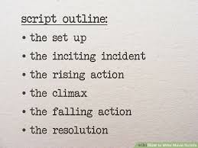

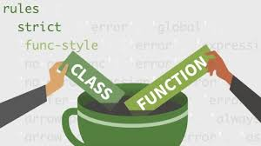

Python Scripts vs. Modules
A script is a .py file that implements a main() function and is meant to run a stand-alone program.
Scripts are run from the command line, like this:
python3 script_name.py
A module is a .py file that implements a set of related classes or functions for use as a library (e.g., for machine learning).
Modules are intended to be imported into a python script or other modules to provide needed functionality.

Slide 56
Importing Modules
These are the only function(s) imported from the module!
You can "import" a module and use its function/classes in your programs.
To import the entire contents of a module, do this:
To import specific item(s) from a module, do this:
import math
def hypot(a,b):
return math.sqrt(a**2+b**2)
For example, the math module holds useful math functions (e.g., sqrt, sin, cos).
from math import sqrt, cos, sin
def hypot(a,b):
return sqrt(a**2+b**2)
To import the entire contents of a module, and eliminate the module prefix, do this:
When you import this way, you must omit the module name prefix!
To import the entire contents of a module, and rename the module for convenience, do this:
#include <iostream>
int main() {
std::cout << "Hello world!\n";
}
To use a function/class from a module, you must prefix with the module's name!
from math import *
def hypot(a,b):
return sqrt(a**2+b**2)
import math as m
def hypot(a,b):
return m.sqrt(a**2+b**2)
This defines m as an alias for math.
It's like the namespace prefix that we use in C++.
Each module implicitly defines its own namespace (e.g., math).
Making calls more convenient.
This prevents collisions between similarly-named functions/classes in different modules.

Slide 57
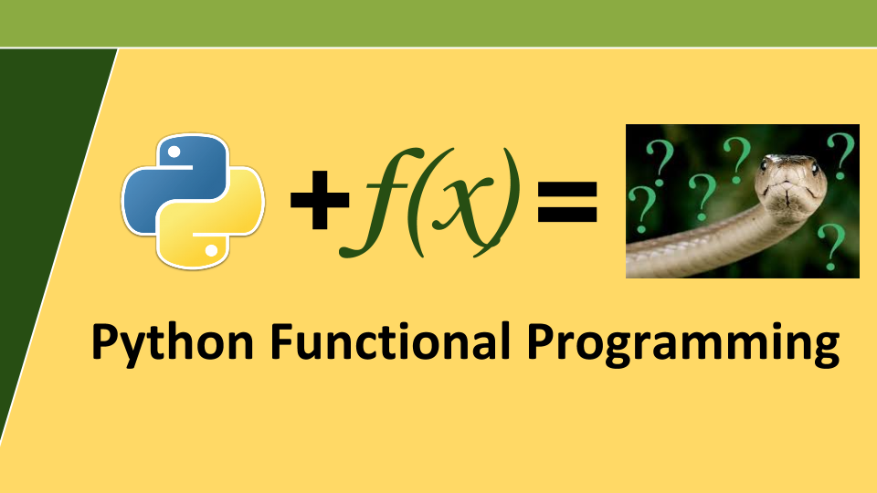
Functional Influences in Python

Slide 58
Functional Influences: Comprehensions
Remember comprehensions from Haskell?
input = [10,11,12,15,17,22,23,5]
doubled_odds = [x*2 | x <- input, x `mod` 2 == 1]
Well, Python has them as well!
And their syntax is pretty close to Haskell's!
input = [10,11,12,15,17,22,23,5]
doubled_odds = [x*2 for x in input if x % 2 == 1]

Slide 59
Functional Influences: Comprehensions
This creates a list of the squares of all numbers between [3,6).
This creates a list of words longer than 6 characters from words.
numz = [x**2 for x in range(3,6)]
print(numz)
words = ['onomatopoeia','goober','incognito','lit']
wordz1 = [w for w in words if len(w) > 6]
print(wordz1)
s = "David's dirty dog drank dirty water down by the dam"
wordz2 = [w for w in s.split() if w[0] == 'd']
print(wordz2)
wordz3 = {w for w in s.split() if w[0] == 'd'} # hint: set
print(wordz3)
wordz4 = {w:len(w) for w in s.split()} # hint: dict
print(wordz4)
This creates a list of all words that start with 'd' from s.
This creates a set of unique words that start with 'd' from s.
This creates a map that associates unique words with their length.
[9, 16, 25]
['onomatopoeia', 'incognito']
['dirty', 'dog', 'drank', 'dirty', 'down', 'dam']
{'drank', 'dam', 'dirty', 'down', 'dog'}
{"David's": 7, 'dirty': 5, 'dog': 3, 'drank': 5, 'water': 5, 'down': 4, 'by': 2, 'the': 3, 'dam': 3}

Slide 60
Functional Influences: Lambdas
Python has a super-simple form of lambdas (anonymous functions)!
Each lambda's body is a single expression (e.g., x+5) on a single line and may refer to the lambda's parameters or variables from the current scope.
The captured variable is now available when the lambda function runs!
The lambda returns the value of the expression – no "return" statement is needed.
The insult_carey function takes a function f as its parameter and calls it!
This lambda accepts a single parameter, e.g., a person's name.
Function f must take a single argument.
And returns the parameter concatenated with an insult.
Let's pass in a lambda that can insult a person by saying they have earwax.
Notice there's no explicit return statement – it's implicit!
p
f
p
f
This lambda captures the lang variable from the enclosing scope!
lambda p:
p + ' has earwax'
def insult_carey(f):
print("It's true: " + f('carey'))
def main():
insult_carey(lambda p: p + ' has earwax')
lang = 'javascript'
insult_carey(lambda p: p + ' codes in ' + lang)
lambda p:
p + ' codes in' + lang
carey
carey
'carey has earwax'
lang
'carey codes in javascript'
lang
'javascript'
'javascript'
It's true: carey has earwax
It's true: carey codes in javascript

Slide 61
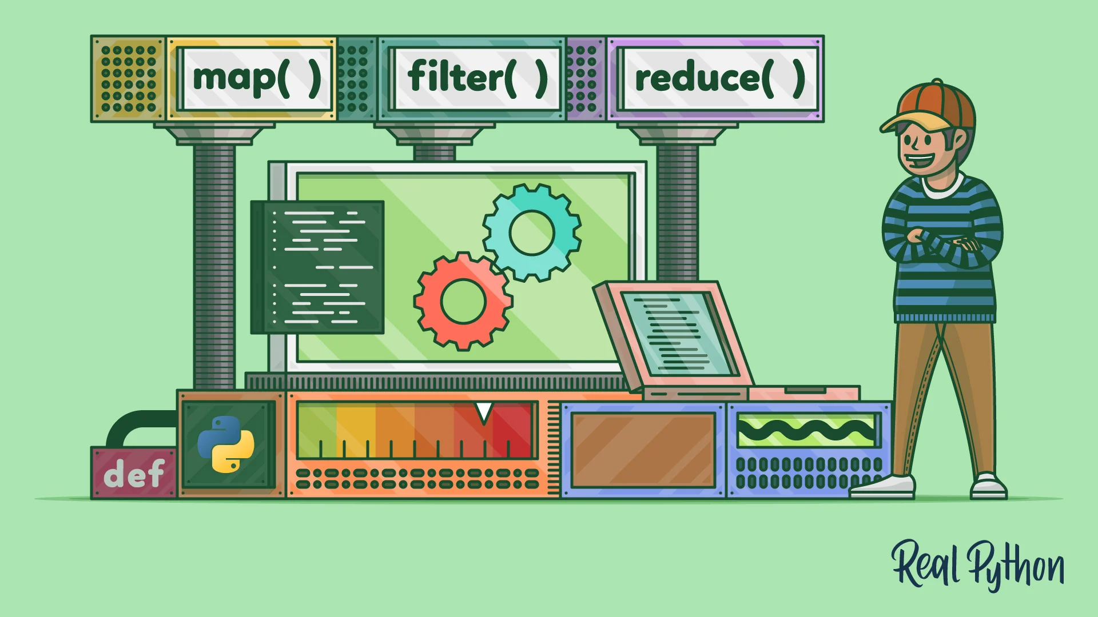
Functional Influences: Map, Filter and Reduce
Python has built-in map, filter and reduce functions!
We won't cover them here, but they're very just what you'd expect.

Slide 62
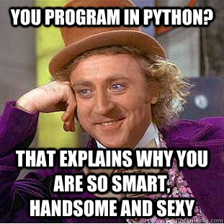
We're Done Learning Python
Hopefully, you now have a flavor for Python and how simple it is!
You now have the tools to write correct code in Python, using google and stack overflow for any topics we didn't cover.
Want a fancy Python cheat sheet?
https://ehmatthes.github.io/pcc_2e/cheat_sheets/cheat_sheets/
Notes:
When designing a language, computer scientists choose one or more approaches for each of these facets.

Slide 63
Appendix
Notes:
When designing a language, computer scientists choose one or more approaches for each of these facets.

Slide 64

Practical Python

Slide 65
Practical Python: Reading and Writing Text Files
Let's first learn how to read from a text file on your hard drive.
Reading from Files
Challenge: What types of things do you think a file object needs to keep track of?
filename = '/Users/climberkip/foo.txt'
Let's add each line of the file to a list.
file_object = open(filename)
To process a file, first we must "open" it.
To read lines from the file, simply enumerate the file object like you would a list!
file_contents = []
for line in file_object:
file_contents.append(line)
Thinking time!
The open() function returns a "file object" which is an ADT that lets us read the contents of the file.
We can then add the line to our list.
file_object.close()
Each loop iteration reads a single line of the file off the disk and points this variable at it.
Finally, its important to close the file object once we're done with it!
# file_contents contains all the lines
Notes:
file objects track: whether the file was opened for reading or writing/modification, the position of a cursor in the file where the next data should be read/written to, whether the file should be accessed as a text file or a binary file, etc.

Slide 66
Practical Python: Reading and Writing Text Files
The with command automatically does this:
file_object = open(filename)
if file_object.was_opened_successfully():
# do a bunch of processing
file_object.close()
Let's first learn how to read from a text file on your hard drive.
Let's see a more idiomatic way of reading files.
Let's use the with command to open our file.
Reading from Files
filename = '/Users/climberkip/foo.txt'
with open(filename) as file_object:
file_contents = []
for line in file_object:
file_contents.append(line)
# The "with" cmd auto-closes the file
# file_contents contains all the lines
filename = '/Users/climberkip/foo.txt'
file_object = open(filename)
file_contents = []
for line in file_object:
file_contents.append(line)
file_object.close()
# file_contents contains all the lines

Slide 67
Practical Python: Reading and Writing Text Files
Let's first learn how to read from a text file on your hard drive.
Ok, now how do we check for errors?
Reading from Files
Here we try to open the file...
filename = '/Users/climberkip/foo.txt'
try:
with open(filename) as file_object:
file_contents = []
for line in file_object:
file_contents.append(line)
except FileNotFoundError:
print('File not found!')
except:
print('Some other error occurred!')
filename = '/Users/climberkip/foo.txt'
with open(filename) as file_object:
file_contents = []
for line in file_object:
file_contents.append(line)
# The "with" cmd auto-closes the file
# file_contents contains all the lines
If the file doesn't exist, execution immediately jumps here!
If some other error occurs (e.g., the file is deleted while reading it), the code jumps here.

Slide 68
Practical Python: Reading and Writing Text Files
Let's first learn how to read from a text file on your hard drive.
Reading from Files
filename = '/Users/climberkip/foo.txt'
with open(filename) as file_object:
file_contents = []
for line in file_object:
file_contents.append(line)
# The "with" cmd auto-closes the file
# file_contents contains all the lines
filename = '/Users/climberkip/foo.txt'
with open(filename) as file_object:
file_contents = []
while True:
line = file_object.readline()
if not line:
break
file_contents.append(line)
You can also do things a bit more manually.
This c0mmand reads a single line from the file, then advances to the next line.
If we've reached the end of the file and try to readline(), it returns an empty string.

Slide 69

Practical Python: Reading and Writing Text Files
"a" means we are appending data onto the end of the file, adding to its original contents.
OK, now let's see how to write to a text file on your hard drive. There are two different options:
Overwriting a File
Appending to a File
These must be strings – other types aren't allowed.
filename = '/Users/climberkip/out.txt'
with open(filename, "w") as file_obj:
file_obj.write('This deletes\n')
file_obj.write('the original file\n')
file_obj.write('and replaces it\n')
file_obj.write('w/these 4 lines\n')
filename = '/Users/climberkip/out.txt'
with open(filename, "a") as file_obj:
file_obj.write('This adds four\n')
file_obj.write('lines to the end\n')
file_obj.write('of the original\n')
file_obj.write('file\n')
"w" means we are opening the file for writing and will delete the original contents first.
out.txt
out.txt
These are the original
file contents.
Sarcastic Robot Says:
This deletes
These are the original
file contents.
the original file
The file object maintains a "write cursor" which indicates where data is to be written.
'What about reading and writing to binary files, Carey?
That's used for applications like databases and big data!'
and replaces it
This adds four
w/these 4 lines
lines to the end
of the original
file

Slide 70
Academic Robot Says:
Practical Python: Processing JSON Config Files
'Don't forget to tell them the meaning of the name, Carey!
JSON is an acronym for JavaScript Object Notation.'
JSON is a standardized textual data format used to store and transmit information.
Common uses include transmitting records from a server to a web browser for rendering and storing configuration settings for an application.
student.json
{
}
Each JSON "object" is enclosed in { bracers }.
"name": "Carey",
The object contains pairs of key strings and values:
"GPA": 3.62,
"classes": ["CS 131", "Math 33B", "CS 151B"]
strings
"address": { "street": "201 Del Monte",
"city": "Los Altos",
"state": "CA", "zip": 94022 }
ints/floats/booleans
Arrays of values
Nested objects
lol_config.json
{
"data_directory": "/Apps/League of Legends/data",
"license_expiration": "12/31/2026",
"registered_user": "Carey Nachenberg",
"app_version": "12.15.1 beta",
}
Notes:
JSON originated with JavaScript, but is now a standard across all languages for data interchange.

Slide 71
Practical Python: Processing JSON Config Files
Python provides built-in support for writing to and reading from JSON files!
Creating/Serializing a JSON File
First, we import Python's json module.
Then we define a dictionary with our keys/values.
import json
course_data = {
"courses":
[ { "name": "CS31", "Units": 4,
"enrollment": "113/250"},
{ "name": "CS32", "Units": 4,
"enrollment": "180/200"},
{ "name": "CS131", "Units": 4,
"enrollment": "5/200"}
],
"quarter": "fall"
}
course_data = {}
course_data["courses"] = []
course_data["courses"].append(
{"name": "CS31", "Units": 4,
"enrollment": "113/250"})
course_data["courses"].append(
{"name": "CS32", "Units": 4,
"enrollment": "180/200"}) ...
course_data["quarter"] = "fall"
Of course, we can create the dictionary programmatically too!
courses.json
Finally, we open the file that we're saving the JSON to for writing...
{"courses": [{"name": "CS31", "Units": 4, "enrollment": "113/250"}, {"name": "CS32", "Units": 4, "enrollment": "180/200"}, {"name": "CS131", "Units": 4, "enrollment": "5/200"}], "quarter": "fall"}
and use the json module's dump() function to save our object in JSON format.
with open("courses.json", "w") as file_obj:
json.dump(course_data, file_obj)

Slide 72
Practical Python: Processing JSON Config Files
Python provides built-in support for writing to and reading from JSON files!
Creating/Serializing a JSON File
Loading/Deserializing a JSON File
import json
import json
course_data = {
"courses":
[ { "name": "CS31", "Units": 4,
"enrollment": "113/250"},
{ "name": "CS32", "Units": 4,
"enrollment": "180/200"},
{ "name": "CS131", "Units": 4,
"enrollment": "5/200"}
],
"quarter": "fall"
}
with open("courses.json", "r") as file_obj:
loaded_data = json.load(file_obj)
print(loaded_data["quarter"])
# prints: fall
print(loaded_data["courses"][1]["name"])
# prints: CS32
Then we use the json module's load function to load the JSON data from the file.
The data is loaded as a Python dictionary, which we can query!
We start by opening the desired JSON file for reading.
with open("courses.json", "w") as file_obj:
json.dump(course_data, file_obj)

Slide 73
Practical Python: Processing JSON Config Strings
Sometimes we won't read JSON data out of a file, but from another source – like a website.
Processing a JSON String
import json
json_str = get_json_weather_data('90024')
dict = json.loads(json_str)
print(f'The temperature is {dict["temp"]} degrees.')
For example, what if we connected to a website and downloaded weather data in JSON format.
In this case, we'll just have a Python string containing JSON data, e.g.:
'{"temp":78.91, "humidity":68}'
We can then use the json.loads (load string) function to convert the JSON string into a dictionary.
Then we can retrieve values from the dictionary as before.

Slide 74




<!doctype html><html itemscope="" itemtype="http://schema.org/SearchResultsPage" lang="en"><head><meta charset="UTF-8"><meta content="dark" name="color-scheme"><meta content="origin" name="referrer"><meta content="/images/branding/googleg/1x/googleg_standard_color_128dp.png" itemprop="image"><title>silly ucla professors - Google Search</title><script nonce="OwkzLyN1vbXz8zVbTyNVJQ">(function(){var b=window. addEventListener ;window.addEventListener=function(a,c,d) {"unload"!==a&&b(a,c,d)};}). call(this);(function(){window.google={kEI:'IRqhYp7HKIrDkPIPnMyp6A0',kEXPI:'31',u:'22bdd498',kBL:'vLTk'};google.sn='web';google.kHL='en';})();(function(){
var f=this||self;var h,k=[];function l(a){for(var b;a&&(!a.getAttribute|| !(b=a.getAttribute("eid")));)a=a.parentNode;return b||h}function m(a){for(var b=null;a&&(!a.getAttribute||!(b=a.getAttribute("leid")));)a=a.parentNode;return b}
Practical Python: Connecting to Websites
Each URL consists of a scheme, a domain, a path, and a query string.
Typically the response will be an HTML page, but it's often JSON too!
https://www.google.com/search?q=silly+ucla+professors
In about 11 lines of Python code, you can make a program that connects to a URL and downloads the webpage!
Let's start by seeing what a web request looks like in a browser...
OK, now let's see it in Python!
Notes:
For this to work for HTTPS, you need to ensure that python has SSL certificates installed, so it can verify the identity of the websites you connect to. To install these certificates on OSX, go to the folder where Python is installed and double click on 'Install Certificates.command' before running this code.

Slide 75
base_url includes the scheme, domain and path, e.g.:
https://www.website.com/login
params is a Python dictionary containing key-value pairs for each parameter, e.g.:
username → kippy
password → fuzzie!123
Practical Python: Connecting to Websites
We start by importing urllib.request and urllib.parse, python modules that enable us to construct a web request.
web.py
import urllib.request
import urllib.parse
def get_web_data(base_url, params = None):
if params is None:
url = base_url
else:
param_str = urllib.parse.urlencode(params)
url = base_url + '?' + param_str
req = urllib.request.Request(url)
with urllib.request.urlopen(req) as response:
web_page = response.read()
return web_page
If there are parameters, we'll convert our dictionary into the proper encoding required by websites, e.g.:
username=kippy&password=fuzzie!123
Next let's define a function that can retrieve a webpage or JSON payload.
If there are no parameters, then we will just send the base_url to the website.
Then we create a special "Request object" from our URL string.
And then create the full URL from the base URL and the parameters, e.g.:
https://www.website.com/login?username=kippy&password=fuzzie!123
And we use the Request object to open a connection to the server identified by the URL.
Finally, we read the data sent by the website and return it!

Slide 76
Practical Python: Connecting to Websites
{
...
"main":
{
"feels_like": 78.91,
"humidity": 68,
"pressure": 1002,
"temp": 78.91,
"temp_max": 103.44,
"temp_min": 62.83
},
"name": "Westwood, Los Angeles",
...
"weather": [{
"description": "overcast clouds",
"icon": "04d",
"id": 804,
"main": "Clouds"
} ],
...
}
OK, let's use our program to retrieve the weather in Westwood in JSON format!
First we'll import the web module we just created.
web.py
import urllib.request
import urllib.parse
def get_web_data(base_url, params = None):
if params is None:
url = base_url
else:
param_str = urllib.parse.urlencode(params)
url = base_url + '?' + param_str
req = urllib.request.Request(url)
with urllib.request.urlopen(req) as response:
web_page = response.read()
return web_page
import web
import json
url = 'https://api.openweathermap.org/data/2.5/weather'
params = {'lat' : '34.070020723033025',
'lon' : '-118.44518231567399',
'units' : 'imperial',
'appid' : 'b36f461....86eb0dc50'}
json_result = web.get_web_data(url, params)
dict = json.loads(json_result)
temperature = dict['main']['temp']
print(f'The temp at UCLA is {temperature}')
Since our website returns weather data in JSON, let's import Python's JSON module too.
We can get our weather data for free at openweatherdata.org!
The website requires the following parameters to retrieve weather.
Now we use our new function to download the weather data in JSON format.
Finally we print out the temp in Fahrenheit!
And we use the json.loads() function to convert the JSON string returned by the website into a dictionary.
Notes:
Imperial units are in fahrenheit

Slide 77

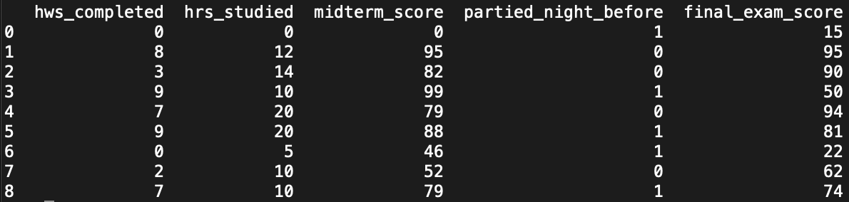
Practical Python:
Python's pandas module makes it easy to analyze, plot, and clean a dataset.
For example, assume we have a dataset that captures people's study habits and exam grades...
Analyze
Plot
Clean
Compute min, max, avg
Compute percentiles
Identify correlations in the data
Plot data from one or more cols
Scatter-plot two columns
Plot histograms for a column
Replace out-of-range values with reasonable replacements
Eliminate rows with missing data

Slide 78
Pandas: Loading Data
Pandas makes it super-easy to import a dataset from a CSV (comma-separated value) file:
You can also create a DataFrame from a python dictionary!
The convention is to rename the pandas module "pd" for simplicity.
python3
climberkip$
study.csv
>>>
import pandas as pd
hws_completed,hrs_studied,midterm_score,partied_night_before,final_exam_score
0,0,0,1,15
8,12,95,0,95
3,14,82,0,90
9,10,99,1,50
7,20,79,0,94
9,17,88,1,81
0,5,46,1,22
2,11,52,0,62
7,9,79,1,74
>>>
df = pd.read_csv('study.csv')
data = {
... "hws_completed": [0,8,3,9,7,9,0,2,7],
... "hrs_studied": [0,12,14,10,20,17,5,11,9],
... "midterm_scores": ...
... }
>>>
And here's how we load a CSV file into Pandas.
read_csv() returns a "DataFrame" object which holds the values from your CSV file.
>>>
df_from_dict = pd.DataFrame(data)

Slide 79
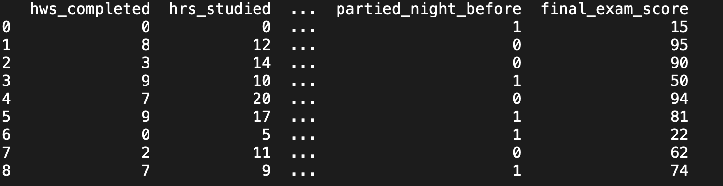
Pandas: Loading Data
Once we load the data, we can make sure it looks valid...
Pandas will size the data to the window, omitting some rows/columns to make it fit.
python3
climberkip$
If you want to get a full dump of the data, you can use:
print(df.to_string())
study.csv
>>>
import pandas as pd
>>>
df = pd.read_csv('study.csv')
hws_completed,hrs_studied,midterm_score,partied_night_before,final_exam_score
0,0,0,1,15
8,12,95,0,95
3,14,82,0,90
9,10,99,1,50
7,20,79,0,94
9,17,88,1,81
0,5,46,1,22
2,11,52,0,62
7,9,79,1,74
>>>
print(df)

Slide 80
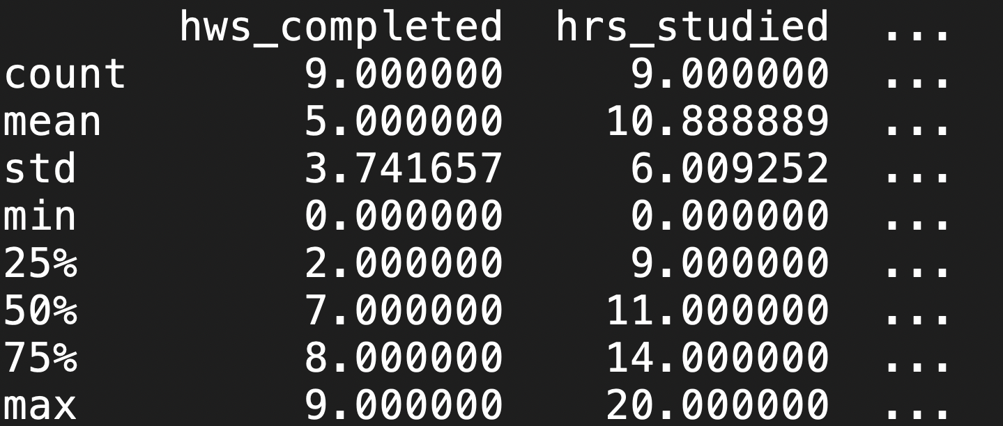
Pandas: Analyzing Data
Once you've loaded your data into a DataFrame, you can ask Pandas to analyze it for you!
python3
climberkip$
study.csv
>>>
import pandas as pd
Let's ask Pandas for a summary of our dataset.
>>>
df = pd.read_csv('study.csv')
hws_completed,hrs_studied,midterm_score,partied_night_before,final_exam_score
0,0,0,1,15
8,12,95,0,95
3,14,82,0,90
9,10,99,1,50
7,20,79,0,94
9,17,88,1,81
0,5,46,1,22
2,11,52,0,62
7,9,79,1,74
>>>
df.describe()
As you can see, Pandas summarizes each column of data for us!

Slide 81
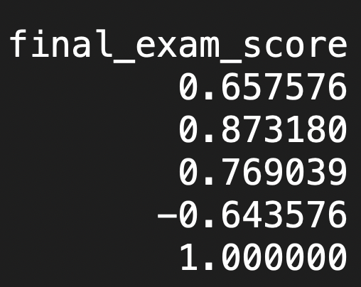
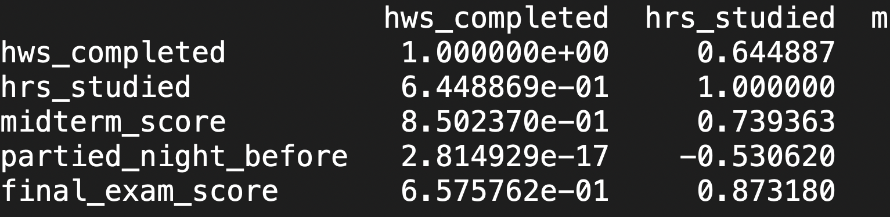
Pandas: Analyzing Data
Once you've loaded your data into a DataFrame, you can ask Pandas to analyze it for you!
python3
climberkip$
We can also ask Pandas to show us correlation between variables!
study.csv
>>>
import pandas as pd
>>>
df = pd.read_csv('study.csv')
hws_completed,hrs_studied,midterm_score,partied_night_before,final_exam_score
0,0,0,1,15
8,12,95,0,95
3,14,82,0,90
9,10,99,1,50
7,20,79,0,94
9,17,88,1,81
0,5,46,1,22
2,11,52,0,62
7,9,79,1,74
>>>
df.corr()
...
For instance, we see there's a negative correlation with partying and doing well on the final!

Slide 82
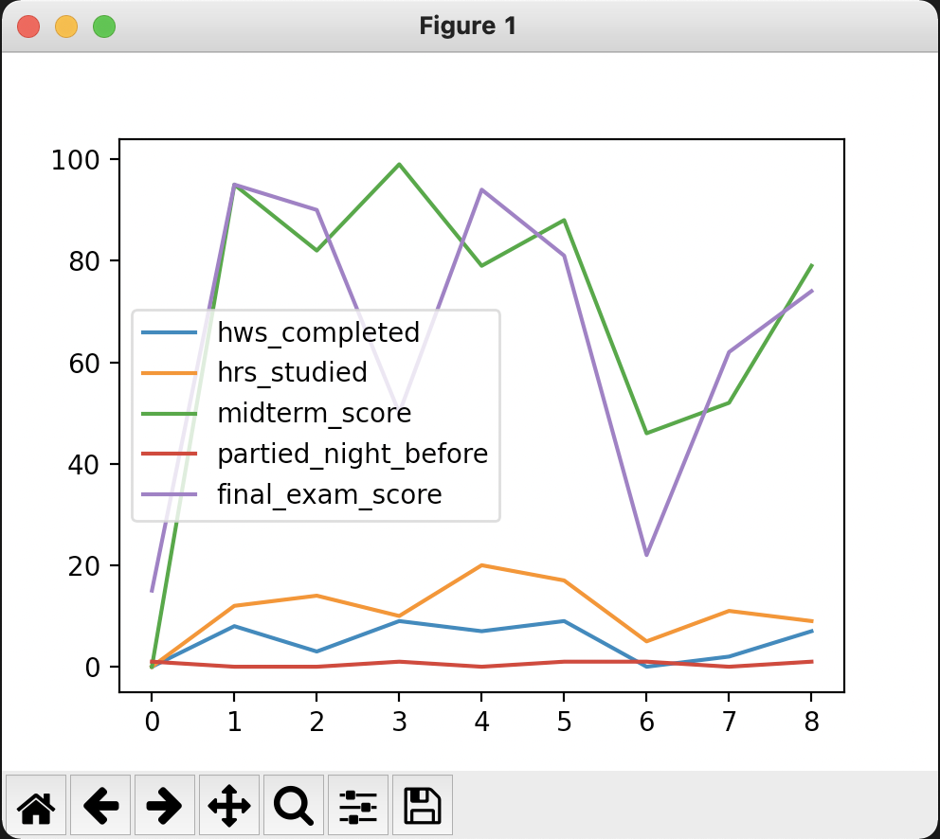
Pandas: Plotting Data
Once you've loaded your data into a DataFrame, you can ask Pandas to plot it as well!
matplolib is a Python plotting library, inspired by the MATLAB analytics system.
Plotting is done in two phases:
First you ask the dataframe to generate the plot (but not display it).
python3
climberkip$
study.csv
>>>
import pandas as pd
>>>
df = pd.read_csv('study.csv')
hws_completed,hrs_studied,midterm_score,partied_night_before,final_exam_score
0,0,0,1,15
8,12,95,0,95
3,14,82,0,90
9,10,99,1,50
7,20,79,0,94
9,17,88,1,81
0,5,46,1,22
2,11,52,0,62
7,9,79,1,74
>>>
import matplotlib
>>>
import matplotlib.pyplot as plt
>>>
df.plot() # creates a plot
>>>
plt.show() # shows plot on screen
Second, you ask the matplotlib to display the plot on the screen.
Let's generate a plot of all of our columns.
Notes:
Matplolib is a Python plotting library, inspired by MATLAB, meaning that the terms used (Axis, Figure, Plots) will be similar to those used in MATLAB.
PyPlot is a shell-like interface to Matplotlib, to make it easier to use for people who are used to MATLAB.

Slide 83
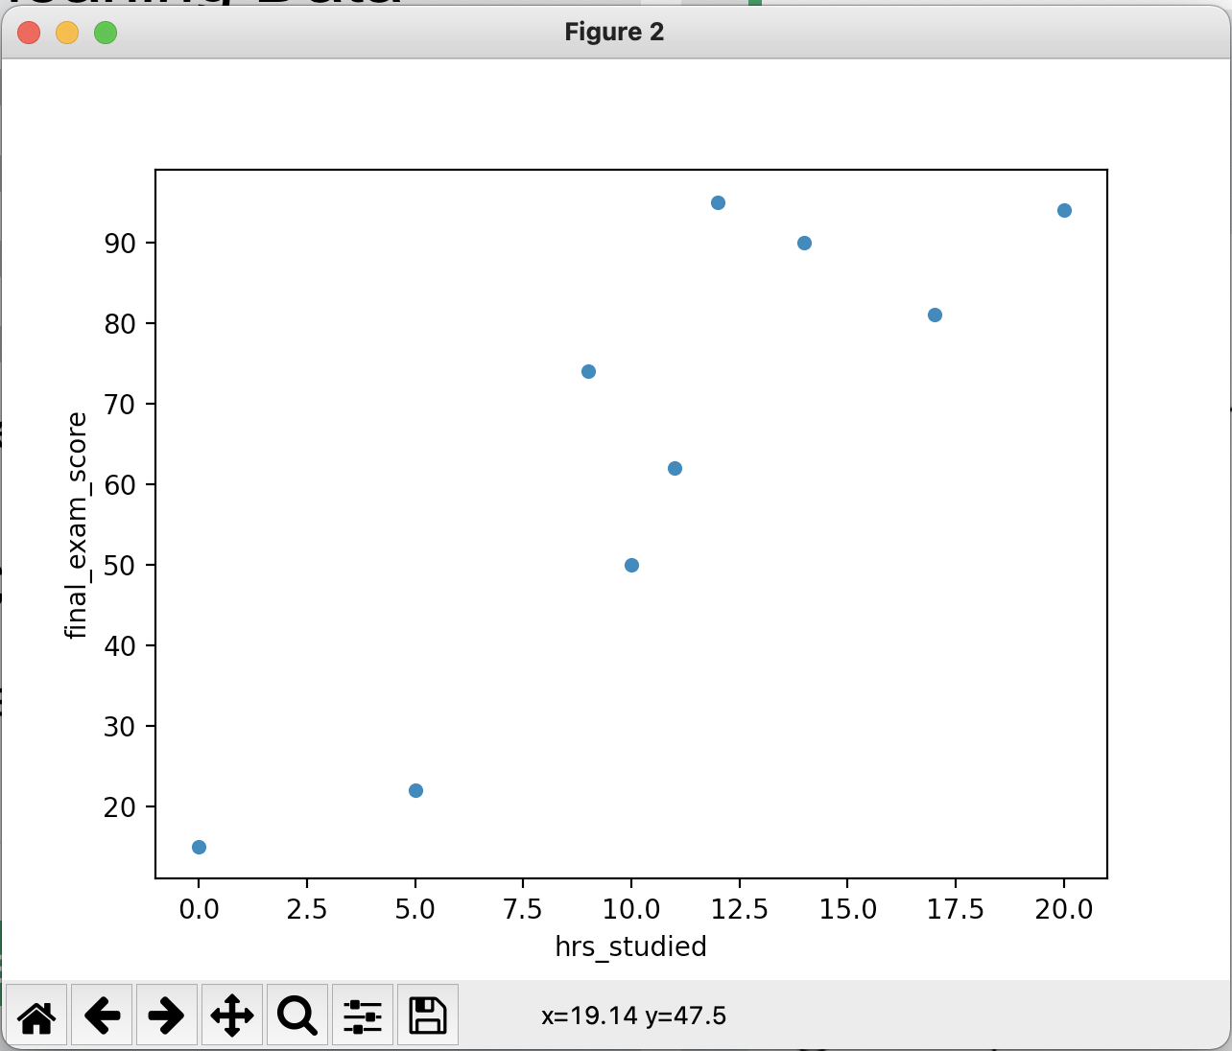
Sarcastic Robot Says:
Pandas: Plotting Data
Hmmmmm...
There's a correlation between studying and your final exam grade. Who knew?!?'
Once you've loaded your data into a DataFrame, you can ask Pandas to plot it as well!
python3
climberkip$
study.csv
>>>
import pandas as pd
>>>
df = pd.read_csv('study.csv')
hws_completed,hrs_studied,midterm_score,partied_night_before,final_exam_score
0,0,0,1,15
8,12,95,0,95
3,14,82,0,90
9,10,99,1,50
7,20,79,0,94
9,17,88,1,81
0,5,46,1,22
2,11,52,0,62
7,9,79,1,74
>>>
import matplotlib
>>>
import matplotlib.pyplot as plt
df.plot(kind = 'scatter', x = 'hrs_studied',
... y = 'final_exam_score')
>>>
>>>
plt.show() # shows plot on screen
Here's how we do a scatter plot comparing hours studied to final exam score!

Slide 84
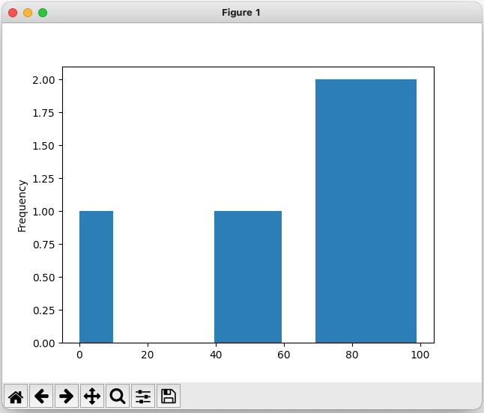
Pandas: Plotting Data
Once you've loaded your data into a DataFrame, you can ask Pandas to plot it as well!
This extracts the specified series of values (e.g., midterm_score) from the data frame, then plots it.
python3
climberkip$
study.csv
>>>
import pandas as pd
>>>
df = pd.read_csv('study.csv')
hws_completed,hrs_studied,midterm_score,partied_night_before,final_exam_score
0,0,0,1,15
8,12,95,0,95
3,14,82,0,90
9,10,99,1,50
7,20,79,0,94
9,17,88,1,81
0,5,46,1,22
2,11,52,0,62
7,9,79,1,74
>>>
import matplotlib
>>>
import matplotlib.pyplot as plt
>>>
df["midterm_score"].plot(kind = 'hist')
>>>
plt.show() # shows plot on screen
Here's how we do a histogram plot for a particular field!

Slide 85
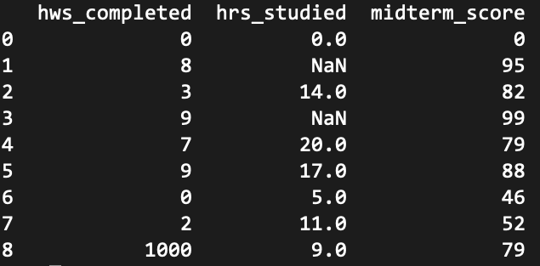
Pandas: Cleaning Data
Sometimes, your data will have gaps or spurious values.
For example, we might have missing data...
python3
climberkip$
Pandas will show missing values as NaN (Not a Number).
study.csv
>>>
import pandas as pd
hws_completed,hrs_studied,midterm_score,partied_night_before,final_exam_score
0,0,0,1,15
8,,95,0,95
3,14,82,0,90
9,,99,1,50
7,20,79,0,94
9,17,88,1,81
0,5,46,1,22
2,11,52,0,62
1000,9,79,1,74
>>>
df = pd.read_csv('study.csv')
hws_completed,hrs_studied,midterm_score,partied_night_before,final_exam_score
0,0,0,1,15
8,12,95,0,95
3,14,82,0,90
9,10,99,1,50
7,20,79,0,94
9,17,88,1,81
0,5,46,1,22
2,11,52,0,62
7,9,79,1,74
>>>
print(df)
Or we might have invalid values. Who studies 1000 hours?!?

Slide 86
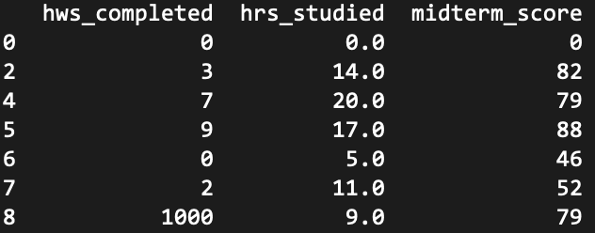
Pandas: Cleaning Data
Pandas makes it easy to drop any row that is missing one or more values!
python3
climberkip$
study.csv
>>>
import pandas as pd
hws_completed,hrs_studied,midterm_score,partied_night_before,final_exam_score
0,0,0,1,15
8,,95,0,95
3,14,82,0,90
9,,99,1,50
7,20,79,0,94
9,17,88,1,81
0,5,46,1,22
2,11,52,0,62
1000,9,79,1,74
>>>
df = pd.read_csv('study.csv')
hws_completed,hrs_studied,midterm_score,partied_night_before,final_exam_score
0,0,0,1,15
8,12,95,0,95
3,14,82,0,90
9,10,99,1,50
7,20,79,0,94
9,17,88,1,81
0,5,46,1,22
2,11,52,0,62
7,9,79,1,74
>>>
df.dropna(inplace = True)
>>>
print(df)
If inplace is True, the dropna() method mutates the current data frame to remove all rows with invalid values.

Slide 87

Pandas: Cleaning Data
Or you can replace missing values with some default/average value...
The fillna() method replaces all NaN values with your chosen value (e.g., the mean, median or mode value).
python3
climberkip$
study.csv
>>>
import pandas as pd
hws_completed,hrs_studied,midterm_score,partied_night_before,final_exam_score
0,0,0,1,15
8,,95,0,95
3,14,82,0,90
9,,99,1,50
7,20,79,0,94
9,17,88,1,81
0,5,46,1,22
2,11,52,0,62
1000,9,79,1,74
>>>
df = pd.read_csv('study.csv')
hws_completed,hrs_studied,midterm_score,partied_night_before,final_exam_score
0,0,0,1,15
8,12,95,0,95
3,14,82,0,90
9,10,99,1,50
7,20,79,0,94
9,17,88,1,81
0,5,46,1,22
2,11,52,0,62
7,9,79,1,74
>>>
m = df["hrs_studied"].mean()
>>>
df["hrs_studied"].fillna(m, inplace = True)
>>>
print(df)
Notes:
The mode is the value that occurs most frequently in a column (e.g., 3, 2, 17, 19, 3, 15 → mode is 3)

Slide 88
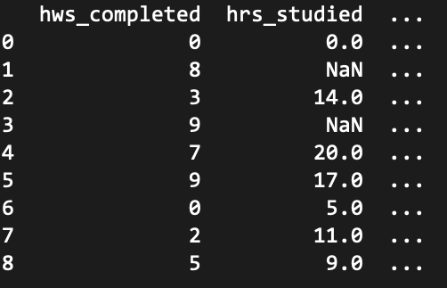
Pandas: Cleaning Data
For a dataset of n rows, df.index returns a Python range(0,n) that lets us iterate over the dataset's rows.
Finally, you can identify out-of-range values and replace them with reasonable replacements.
python3
climberkip$
study.csv
>>>
import pandas as pd
hws_completed,hrs_studied,midterm_score,partied_night_before,final_exam_score
0,0,0,1,15
8,,95,0,95
3,14,82,0,90
9,,99,1,50
7,20,79,0,94
9,17,88,1,81
0,5,46,1,22
2,11,52,0,62
1000,9,79,1,74
>>>
df = pd.read_csv('study.csv')
hws_completed,hrs_studied,midterm_score,partied_night_before,final_exam_score
0,0,0,1,15
8,12,95,0,95
3,14,82,0,90
9,10,99,1,50
7,20,79,0,94
9,17,88,1,81
0,5,46,1,22
2,11,52,0,62
7,9,79,1,74
for row in df.index:
... if df.loc[row, "hws_completed"] > 10:
... df.loc[row, "hws_completed"] = 5
>>>
So now we can replace all values that are invalid with a replacement (e.g., the mean).
>>>
print(df)
We can then use df.loc[row] to access the data at a particular row of the dataset.
...

Slide 89

Practical Python: Integrating with C++
Python is an interpreted language, so it's pretty slow.
Yet it's the primary tool for tasks like machine learning and data science, which require very efficient computation.
To accomplish this, Python has the ability to import and use functions and classes written in C++!
Let's see how to create a C++ module that can be used in Python – this is how Tensorflow, Numpy, or Pandas work!

Slide 90
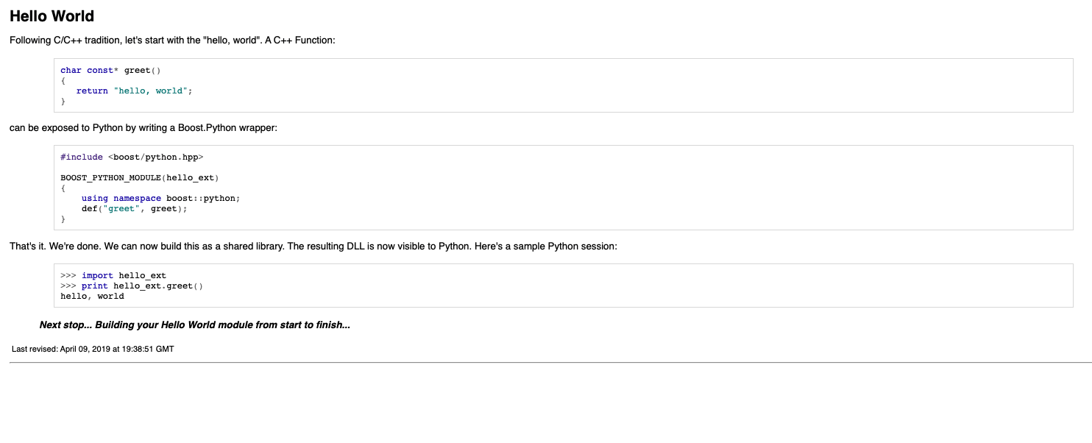
Practical Python: Integrating with C++
Sarcastic Robot Says:
Step #2: Write your C++ classes/functions and register them with Python.boost.
'Compilation/linking of boost C++ modules is pretty poorly documented and takes some time and google searching.'
shapes.cpp
Step #1: Install Python.boost
#include <boost/python.hpp>
using namespace boost::python;
class Circle {
public:
Circle(double rad)
{ this->rad = rad; }
double area() { return 3.14159 * rad * rad; }
double circum() { return 2 * 3.14159 * rad; }
private:
double rad;
};
BOOST_PYTHON_MODULE(shapes) {
class_<Circle>("Circle", init<double>())
.def("area", &Circle::area)
.def("circum", &Circle::circum);
}
Step #3: Compile your C++ code
Let's import our new module.
This specifies your module name – e.g. for module shapes we'd "import shapes".
Step #4: Use your C++ code in Python!
This specifies that your Circle class constructor takes a single double as an argument.
python3
climberkip$
>>>
import shapes
>>>
c = shapes.Circle(10)
>>>
print(f'The area is: {c.area()}')
This registers the public methods of the class.
314.159
Notes:
Compilation of code that uses the boost libraries is quite difficult and there are lots of command line options. Here's what worked for me.
g++ -I/usr/include/python3.9 -fpic shapes.cpp -shared `python3.9-config --ldflags` -lboost_python39 -lpython3.9 -o shapes.so

Slide 91
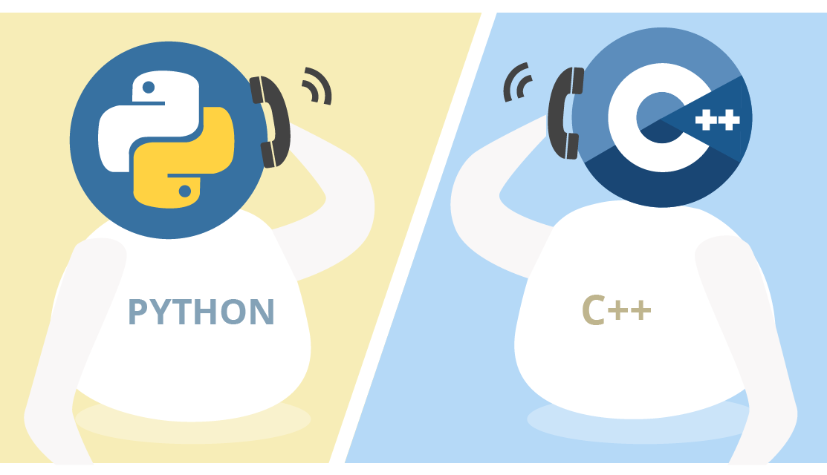
Practical Python: Integrating with C++
With boost, SWIG, or CLIF you can create high-performance modules in C++ and import them in your Python programs!
This gives you the best of both worlds – Python's simplicity with C++'s speed!
boost, SWIG or CLIF

Slide 92
Practical Python

Slide 93
Practical Python: Reading and Writing Text Files
Let's first learn how to read from a text file on your hard drive.
Reading from Files
Challenge: What types of things you think a file object needs to keep track of?
filename = '/Users/climberkip/foo.txt'
Let's add each line of the file to a list.
file_object = open(filename)
To process a file, first we must "open" it.
To read lines from the file, simply enumerate the file object like you would a list!
file_contents = []
for line in file_object:
file_contents.append(line)
Thinking time!
The open() function returns a "file object" which is an ADT that lets us read the contents of the file.
We can then add the line to our list.
file_object.close()
Each loop iteration reads a single line of the file off the disk and points this variable at it.
Finally, its important to close the file object once we're done with it!
# file_contents contains all the lines
Notes:
file objects track: whether the file was opened for reading or writing/modification, the position of a cursor in the file where the next data should be read/written to, whether the file should be accessed as a text file or a binary file, etc.

Slide 94
Practical Python: Reading and Writing Text Files
The with command automatically does this:
file_object = open(filename)
if file_object.was_opened_successfully():
# do a bunch of processing
file_object.close()
Let's first learn how to read from a text file on your hard drive.
Let's see a more idiomatic way of reading files.
Let's use the with command to open our file.
Reading from Files
filename = '/Users/climberkip/foo.txt'
with open(filename) as file_object:
file_contents = []
for line in file_object:
file_contents.append(line)
# The "with" cmd auto-closes the file
# file_contents contains all the lines
filename = '/Users/climberkip/foo.txt'
file_object = open(filename)
file_contents = []
for line in file_object:
file_contents.append(line)
file_object.close()
# file_contents contains all the lines

Slide 95
Practical Python: Reading and Writing Text Files
Let's first learn how to read from a text file on your hard drive.
Ok, now how do we check for errors?
Reading from Files
Here we try to open the file...
filename = '/Users/climberkip/foo.txt'
try:
with open(filename) as file_object:
file_contents = []
for line in file_object:
file_contents.append(line)
except FileNotFoundError:
print('File not found!')
except:
print('Some other error occurred!')
filename = '/Users/climberkip/foo.txt'
with open(filename) as file_object:
file_contents = []
for line in file_object:
file_contents.append(line)
# The "with" cmd auto-closes the file
# file_contents contains all the lines
If the file doesn't exist, execution immediately jumps here!
If some other error occurs (e.g., the file is deleted while reading it), the code jumps here.

Slide 96
Practical Python: Reading and Writing Text Files
Let's first learn how to read from a text file on your hard drive.
Reading from Files
filename = '/Users/climberkip/foo.txt'
with open(filename) as file_object:
file_contents = []
for line in file_object:
file_contents.append(line)
# The "with" cmd auto-closes the file
# file_contents contains all the lines
filename = '/Users/climberkip/foo.txt'
with open(filename) as file_object:
file_contents = []
while True:
line = file_object.readline()
if not line:
break
file_contents.append(line)
You can also do things a bit more manually.
This c0mmand reads a single line from the file, then advances to the next line.
If we've reached the end of the file and try to readline(), it returns an empty string.

Slide 97
Practical Python: Reading and Writing Text Files
"a" means we are appending data onto the end of the file, adding to its original contents.
OK, now let's see how to write to a text file on your hard drive. There are two different options:
Overwriting a File
Appending to a File
These must be strings – other types aren't allowed.
filename = '/Users/climberkip/out.txt'
with open(filename, "w") as file_obj:
file_obj.write('This deletes\n')
file_obj.write('the original file\n')
file_obj.write('and replaces it\n')
file_obj.write('w/these 4 lines\n')
filename = '/Users/climberkip/out.txt'
with open(filename, "a") as file_obj:
file_obj.write('This adds four\n')
file_obj.write('lines to the end\n')
file_obj.write('of the original\n')
file_obj.write('file\n')
"w" means we are opening the file for writing and will delete the original contents first.
out.txt
out.txt
These are the original
file contents.
Sarcastic Robot Says:
This deletes
These are the original
file contents.
the original file
The file object maintains a "write cursor" which indicates where data is to be written.
'What about reading and writing to binary files, Carey?
That's used for applications like databases and big data!'
and replaces it
This adds four
w/these 4 lines
lines to the end
of the original
file

Slide 98
Academic Robot Says:
Practical Python: Processing JSON Config Files
'Don't forget to tell them the meaning of the name, Carey!
JSON is an acronym for JavaScript Object Notation.'
JSON is a standardized textual data format used to store and transmit information.
Common uses include transmitting records from a server to a web browser for rendering and storing configuration settings for an application.
student.json
{
}
Each JSON "object" is enclosed in { bracers }.
"name": "Carey",
The object contains pairs of key strings and values:
"GPA": 3.62,
"classes": ["CS 131", "Math 33B", "CS 151B"]
strings
"address": { "street": "201 Del Monte",
"city": "Los Altos",
"state": "CA", "zip": 94022 }
ints/floats/booleans
Arrays of values
Nested objects
lol_config.json
{
"data_directory": "/Apps/League of Legends/data",
"license_expiration": "12/31/2026",
"registered_user": "Carey Nachenberg",
"app_version": "12.15.1 beta",
}
Notes:
JSON originated with JavaScript, but is now a standard across all languages for data interchange.

Slide 99
Practical Python: Processing JSON Config Files
Python provides built-in support for writing to and reading from JSON files!
Creating/Serializing a JSON File
First, we import Python's json module.
Then we define a dictionary with our keys/values.
import json
course_data = {
"courses":
[ { "name": "CS31", "Units": 4,
"enrollment": "113/250"},
{ "name": "CS32", "Units": 4,
"enrollment": "180/200"},
{ "name": "CS131", "Units": 4,
"enrollment": "5/200"}
],
"quarter": "fall"
}
course_data = {}
course_data["courses"] = []
course_data["courses"].append(
{"name": "CS31", "Units": 4,
"enrollment": "113/250"})
course_data["courses"].append(
{"name": "CS32", "Units": 4,
"enrollment": "180/200"}) ...
course_data["quarter"] = "fall"
Of course, we can create the dictionary programmatically too!
courses.json
Finally, we open the file that we're saving the JSON to for writing...
{"courses": [{"name": "CS31", "Units": 4, "enrollment": "113/250"}, {"name": "CS32", "Units": 4, "enrollment": "180/200"}, {"name": "CS131", "Units": 4, "enrollment": "5/200"}], "quarter": "fall"}
and use the json module's dump() function to save our object in JSON format.
with open("courses.json", "w") as file_obj:
json.dump(course_data, file_obj)

Slide 100
Practical Python: Processing JSON Config Files
Python provides built-in support for writing to and reading from JSON files!
Creating/Serializing a JSON File
Loading/Deserializing a JSON File
import json
import json
course_data = {
"courses":
[ { "name": "CS31", "Units": 4,
"enrollment": "113/250"},
{ "name": "CS32", "Units": 4,
"enrollment": "180/200"},
{ "name": "CS131", "Units": 4,
"enrollment": "5/200"}
],
"quarter": "fall"
}
with open("courses.json", "r") as file_obj:
loaded_data = json.load(file_obj)
print(loaded_data["quarter"])
# prints: fall
print(loaded_data["courses"][1]["name"])
# prints: CS32
Then we use the json module's load function to load the JSON data from the file.
The data is loaded as a Python dictionary, which we can query!
We start by opening the desired JSON file for reading.
with open("courses.json", "w") as file_obj:
json.dump(course_data, file_obj)

Slide 101
Practical Python: Processing JSON Config Strings
Sometimes we won't read JSON data out of a file, but from another source – like a website.
Processing a JSON String
import json
json_str = get_json_weather_data('90024')
dict = json.loads(json_str)
print(f'The temperature is {dict["temp"]} degrees.')
For example, what if we connected to a website and downloaded weather data in JSON format.
In this case, we'll just have a Python string containing JSON data, e.g.:
'{"temp":78.91, "humidity":68}'
We can then use the json.loads (load string) function to convert the JSON string into a dictionary.
Then we can retrieve values from the dictionary as before.

Slide 102
<!doctype html><html itemscope="" itemtype="http://schema.org/SearchResultsPage" lang="en"><head><meta charset="UTF-8"><meta content="dark" name="color-scheme"><meta content="origin" name="referrer"><meta content="/images/branding/googleg/1x/googleg_standard_color_128dp.png" itemprop="image"><title>silly ucla professors - Google Search</title><script nonce="OwkzLyN1vbXz8zVbTyNVJQ">(function(){var b=window. addEventListener ;window.addEventListener=function(a,c,d) {"unload"!==a&&b(a,c,d)};}). call(this);(function(){window.google={kEI:'IRqhYp7HKIrDkPIPnMyp6A0',kEXPI:'31',u:'22bdd498',kBL:'vLTk'};google.sn='web';google.kHL='en';})();(function(){
var f=this||self;var h,k=[];function l(a){for(var b;a&&(!a.getAttribute|| !(b=a.getAttribute("eid")));)a=a.parentNode;return b||h}function m(a){for(var b=null;a&&(!a.getAttribute||!(b=a.getAttribute("leid")));)a=a.parentNode;return b}
Practical Python: Connecting to Websites
Each URL consists of a scheme, a domain, a path, and a query string.
Typically the response will be an HTML page, but it's often JSON too!
https://www.google.com/search?q=silly+ucla+professors
In about 11 lines of Python code, you can make a program that connects to a URL and downloads the webpage!
Let's start by seeing what a web request looks like in a browser...
OK, now let's see it in Python!
Notes:
For this to work for HTTPS, you need to ensure that python has SSL certificates installed, so it can verify the identity of the websites you connect to. To install these certificates on OSX, go to the folder where Python is installed and double click on 'Install Certificates.command' before running this code.

Slide 103
base_url includes the scheme, domain and path, e.g.:
https://www.website.com/login
params is a Python dictionary containing key-value pairs for each parameter, e.g.:
username → kippy
password → fuzzie!123
Practical Python: Connecting to Websites
We start by importing urllib.request and urllib.parse, python modules that enable us to construct a web request.
web.py
import urllib.request
import urllib.parse
def get_web_data(base_url, params = None):
if params is None:
url = base_url
else:
param_str = urllib.parse.urlencode(params)
url = base_url + '?' + param_str
req = urllib.request.Request(url)
with urllib.request.urlopen(req) as response:
web_page = response.read()
return web_page
If there are parameters, we'll convert our dictionary into the proper encoding required by websites, e.g.:
username=kippy&password=fuzzie!123
Next let's define a function that can retrieve a webpage or JSON payload.
If there are no parameters, then we will just send the base_url to the website.
Then we create a special "Request object" from our URL string.
And then create the full URL From the base URL and the parameters, e.g.:
https://www.website.com/login?username=kippy&password=fuzzie!123
And we use the Request object to open a connection to the server identified by the URL.
Finally, we read the data sent by the website and return it!

Slide 104
Practical Python: Connecting to Websites
{
...
"main":
{
"feels_like": 78.91,
"humidity": 68,
"pressure": 1002,
"temp": 78.91,
"temp_max": 103.44,
"temp_min": 62.83
},
"name": "Westwood, Los Angeles",
...
"weather": [{
"description": "overcast clouds",
"icon": "04d",
"id": 804,
"main": "Clouds"
} ],
...
}
OK, let's use our program to retrieve the weather in Westwood in JSON format!
First we'll import the web module we just created.
web.py
import urllib.request
import urllib.parse
def get_web_data(base_url, params = None):
if params is None:
url = base_url
else:
param_str = urllib.parse.urlencode(params)
url = base_url + '?' + param_str
req = urllib.request.Request(url)
with urllib.request.urlopen(req) as response:
web_page = response.read()
return web_page
import web
import json
url = 'https://api.openweathermap.org/data/2.5/weather'
params = {'lat' : '34.070020723033025',
'lon' : '-118.44518231567399',
'units' : 'imperial',
'appid' : 'b36f461....86eb0dc50'}
json_result = web.get_web_data(url, params)
dict = json.loads(json_result)
temperature = dict['main']['temp']
print(f'The temp at UCLA is {temperature}')
Since our website returns weather data in JSON, let's import Python's JSON module too.
We can get our weather data for free at openweatherdata.org!
The website requires the following parameters to retrieve weather.
Now we use our new function to download the weather data in JSON format.
Finally we print out the temp in Fahrenheit!
And we use the json.loads() function to convert the JSON string returned by the website into a dictionary.
Notes:
Imperial units are in fahrenheit

Slide 105
Practical Python:
Python's pandas module makes it easy to analyze, plot, and clean a dataset.
For example, assume we have a dataset that captures people's study habits and exam grades...
Analyze
Plot
Clean
Compute min, max, avg
Compute percentiles
Identify correlations in the data
Plot data from one or more cols
Scatter-plot two columns
Plot histograms for a column
Replace out-of-range values with reasonable replacements
Eliminate rows with missing data

Slide 106
Pandas: Loading Data
Pandas makes it super-easy to import a dataset from a CSV (comma-separated value) file:
You can also create a DataFrame from a python dictionary!
The convention is to rename the pandas module "pd" for simplicity.
python3
climberkip$
study.csv
>>>
import pandas as pd
hws_completed,hrs_studied,midterm_score,partied_night_before,final_exam_score
0,0,0,1,15
8,12,95,0,95
3,14,82,0,90
9,10,99,1,50
7,20,79,0,94
9,17,88,1,81
0,5,46,1,22
2,11,52,0,62
7,9,79,1,74
>>>
df = pd.read_csv('study.csv')
data = {
... "hws_completed": [0,8,3,9,7,9,0,2,7],
... "hrs_studied": [0,12,14,10,20,17,5,11,9],
... "midterm_scores": ...
... }
>>>
And here's how we load a CSV file into Pandas.
read_csv() returns a "DataFrame" object which holds the values from your CSV file.
>>>
df_from_dict = pd.DataFrame(data)

Slide 107
Pandas: Loading Data
Once we load the data, we can make sure it looks valid...
Pandas will size the data to the window, omitting some rows/columns to make it fit.
python3
climberkip$
If you want to get a full dump of the data, you can use:
print(df.to_string())
study.csv
>>>
import pandas as pd
>>>
df = pd.read_csv('study.csv')
hws_completed,hrs_studied,midterm_score,partied_night_before,final_exam_score
0,0,0,1,15
8,12,95,0,95
3,14,82,0,90
9,10,99,1,50
7,20,79,0,94
9,17,88,1,81
0,5,46,1,22
2,11,52,0,62
7,9,79,1,74
>>>
print(df)

Slide 108
Pandas: Analyzing Data
Once you've loaded your data into a DataFrame, you can ask Pandas to analyze it for you!
python3
climberkip$
study.csv
>>>
import pandas as pd
Let's ask Pandas for a summary of our dataset.
>>>
df = pd.read_csv('study.csv')
hws_completed,hrs_studied,midterm_score,partied_night_before,final_exam_score
0,0,0,1,15
8,12,95,0,95
3,14,82,0,90
9,10,99,1,50
7,20,79,0,94
9,17,88,1,81
0,5,46,1,22
2,11,52,0,62
7,9,79,1,74
>>>
df.describe()
As you can see, Pandas summarizes each column of data for us!

Slide 109
Pandas: Analyzing Data
Once you've loaded your data into a DataFrame, you can ask Pandas to analyze it for you!
python3
climberkip$
We can also ask Pandas to show us correlation between variables!
study.csv
>>>
import pandas as pd
>>>
df = pd.read_csv('study.csv')
hws_completed,hrs_studied,midterm_score,partied_night_before,final_exam_score
0,0,0,1,15
8,12,95,0,95
3,14,82,0,90
9,10,99,1,50
7,20,79,0,94
9,17,88,1,81
0,5,46,1,22
2,11,52,0,62
7,9,79,1,74
>>>
df.corr()
...
For instance, we see there's a negative correlation with partying and doing well on the final!

Slide 110
Pandas: Plotting Data
Once you've loaded your data into a DataFrame, you can ask Pandas to plot it as well!
matplolib is a Python plotting library, inspired by the MATLAB analytics system.
Plotting is done in two phases:
First you ask the dataframe to generate the plot (but not display it).
python3
climberkip$
study.csv
>>>
import pandas as pd
>>>
df = pd.read_csv('study.csv')
hws_completed,hrs_studied,midterm_score,partied_night_before,final_exam_score
0,0,0,1,15
8,12,95,0,95
3,14,82,0,90
9,10,99,1,50
7,20,79,0,94
9,17,88,1,81
0,5,46,1,22
2,11,52,0,62
7,9,79,1,74
>>>
import matplotlib
>>>
import matplotlib.pyplot as plt
>>>
df.plot() # creates a plot
>>>
plt.show() # shows plot on screen
Second, you ask the matplotlib to display the plot on the screen.
Let's generate a plot of all of our columns.
Notes:
Matplolib is a Python plotting library, inspired by MATLAB, meaning that the terms used (Axis, Figure, Plots) will be similar to those used in MATLAB.
PyPlot is a shell-like interface to Matplotlib, to make it easier to use for people who are used to MATLAB.

Slide 111
Sarcastic Robot Says:
Pandas: Plotting Data
Hmmmmm...
There's a correlation between studying and your final exam grade. Who knew?!?'
Once you've loaded your data into a DataFrame, you can ask Pandas to plot it as well!
python3
climberkip$
study.csv
>>>
import pandas as pd
>>>
df = pd.read_csv('study.csv')
hws_completed,hrs_studied,midterm_score,partied_night_before,final_exam_score
0,0,0,1,15
8,12,95,0,95
3,14,82,0,90
9,10,99,1,50
7,20,79,0,94
9,17,88,1,81
0,5,46,1,22
2,11,52,0,62
7,9,79,1,74
>>>
import matplotlib
>>>
import matplotlib.pyplot as plt
df.plot(kind = 'scatter', x = 'hrs_studied',
... y = 'final_exam_score')
>>>
>>>
plt.show() # shows plot on screen
Here's how we do a scatter plot comparing hours studied to final exam score!

Slide 112
Pandas: Plotting Data
Once you've loaded your data into a DataFrame, you can ask Pandas to plot it as well!
This extracts the specified series of values (e.g., midterm_score) from the data frame, then plots it.
python3
climberkip$
study.csv
>>>
import pandas as pd
>>>
df = pd.read_csv('study.csv')
hws_completed,hrs_studied,midterm_score,partied_night_before,final_exam_score
0,0,0,1,15
8,12,95,0,95
3,14,82,0,90
9,10,99,1,50
7,20,79,0,94
9,17,88,1,81
0,5,46,1,22
2,11,52,0,62
7,9,79,1,74
>>>
import matplotlib
>>>
import matplotlib.pyplot as plt
>>>
df["midterm_score"].plot(kind = 'hist')
>>>
plt.show() # shows plot on screen
Here's how we do a histogram plot for a particular field!

Slide 113
Pandas: Cleaning Data
Sometimes, your data will have gaps or spurious values.
For example, we might have missing data...
python3
climberkip$
Pandas will show missing values as NaN (Not a Number).
study.csv
>>>
import pandas as pd
hws_completed,hrs_studied,midterm_score,partied_night_before,final_exam_score
0,0,0,1,15
8,,95,0,95
3,14,82,0,90
9,,99,1,50
7,20,79,0,94
9,17,88,1,81
0,5,46,1,22
2,11,52,0,62
1000,9,79,1,74
>>>
df = pd.read_csv('study.csv')
hws_completed,hrs_studied,midterm_score,partied_night_before,final_exam_score
0,0,0,1,15
8,12,95,0,95
3,14,82,0,90
9,10,99,1,50
7,20,79,0,94
9,17,88,1,81
0,5,46,1,22
2,11,52,0,62
7,9,79,1,74
>>>
print(df)
Or we might have invalid values. Who studies 1000 hours?!?

Slide 114
Pandas: Cleaning Data
Pandas makes it easy to drop any row that is missing one or more values!
python3
climberkip$
study.csv
>>>
import pandas as pd
hws_completed,hrs_studied,midterm_score,partied_night_before,final_exam_score
0,0,0,1,15
8,,95,0,95
3,14,82,0,90
9,,99,1,50
7,20,79,0,94
9,17,88,1,81
0,5,46,1,22
2,11,52,0,62
1000,9,79,1,74
>>>
df = pd.read_csv('study.csv')
hws_completed,hrs_studied,midterm_score,partied_night_before,final_exam_score
0,0,0,1,15
8,12,95,0,95
3,14,82,0,90
9,10,99,1,50
7,20,79,0,94
9,17,88,1,81
0,5,46,1,22
2,11,52,0,62
7,9,79,1,74
>>>
df.dropna(inplace = True)
>>>
print(df)
If inplace is True, the dropna() method mutates the current data frame to remove all rows with invalid values.

Slide 115
Pandas: Cleaning Data
Or you can replace missing values with some default/average value...
The fillna() method replaces all NaN values with your chosen value (e.g., the mean, median or mode value).
python3
climberkip$
study.csv
>>>
import pandas as pd
hws_completed,hrs_studied,midterm_score,partied_night_before,final_exam_score
0,0,0,1,15
8,,95,0,95
3,14,82,0,90
9,,99,1,50
7,20,79,0,94
9,17,88,1,81
0,5,46,1,22
2,11,52,0,62
1000,9,79,1,74
>>>
df = pd.read_csv('study.csv')
hws_completed,hrs_studied,midterm_score,partied_night_before,final_exam_score
0,0,0,1,15
8,12,95,0,95
3,14,82,0,90
9,10,99,1,50
7,20,79,0,94
9,17,88,1,81
0,5,46,1,22
2,11,52,0,62
7,9,79,1,74
>>>
m = df["hrs_studied"].mean()
>>>
df["hrs_studied"].fillna(m, inplace = True)
>>>
print(df)
Notes:
The mode is the value that occurs most frequently in a column (e.g., 3, 2, 17, 19, 3, 15 → mode is 3)

Slide 116
Pandas: Cleaning Data
For a dataset of n rows, df.index returns a Python range(0,n) that lets us iterate over the dataset's rows.
Finally, you can identify out-of-range values and replace them with reasonable replacements.
python3
climberkip$
study.csv
>>>
import pandas as pd
hws_completed,hrs_studied,midterm_score,partied_night_before,final_exam_score
0,0,0,1,15
8,,95,0,95
3,14,82,0,90
9,,99,1,50
7,20,79,0,94
9,17,88,1,81
0,5,46,1,22
2,11,52,0,62
1000,9,79,1,74
>>>
df = pd.read_csv('study.csv')
hws_completed,hrs_studied,midterm_score,partied_night_before,final_exam_score
0,0,0,1,15
8,12,95,0,95
3,14,82,0,90
9,10,99,1,50
7,20,79,0,94
9,17,88,1,81
0,5,46,1,22
2,11,52,0,62
7,9,79,1,74
for row in df.index:
... if df.loc[row, "hws_completed"] > 10:
... df.loc[row, "hws_completed"] = 5
>>>
So now we can replace all values that are invalid with a replacement (e.g., the mean).
>>>
print(df)
We can then use df.loc[row] to access the data at a particular row of the dataset.
...

Slide 117
Rapid-Fire Python: Parameter Passing & Modification
Academic Robot Says:
'Carey – this is grossly incorrect.
As any competent programmer knows, Python passes ALL arguments by object reference! Tsk tsk.'
You can reason about Python's parameter passing in the following way...
All primitives and tuples are passed by value.
All objects are essentially passed by pointer...
Therefore, all changes made to primitive arguments are lost when the function returns.
They can be changed with bracket notation (e.g., lst[0]='y') or mutator methods (e.g., lst.append('x')).
BUT... all changes made via assignment are lost upon return!
This statement changes the local sch pointer...
sch
p
q
r
def will_work1(sch):
sch[2] = 'Harvard' # changes top_schools!
def will_work2(sch):
sch.append('Princeton') # changes top_schools!
top_schools = ['UCLA','UCB','Stanford']
will_work1(top_schools) # UCLA, UCB, Harvard!
will_work2(top_schools) # UCLA, UCB, Harv, Prin
'Harvard'
def foo(p, q, r):
p = 10 # all of these changes
q = 'geek' # are lost upon return
r = (1.0, 'x')
a = 0
b = 'nerd'
c = (5, 6)
foo(a, b, c)
10
sch
'geek'
'Princeton'
(1.0, 'x')
sch
'USC'
def wont_work(sch):
sch = ['USC'] # changes lost upon return!
Sarcastic Robot Says:
Original values are unchanged!
a
0
0
top_schools
'Whoa!!? Chill academic-bot!
Carey will get into the details later – and as he says, this is just how to reason about it!'
'UCLA'
'UCB'
'Stanford'
b
'nerd'
'nerd'
...but does nothing to the original list!
c
(5,6)
(5,6)
wont_work(top_schools) # nothing changes!!!

Slide 118
Rapid-Fire Python: Conversions and Casting
// Arithmetic operators in C++
int i1 = 5, i2;
float f1 = 1.5, f2;
f2 = i1 + f1; // i1 converted to float
f2 = static_cast<float>(i1); // 5.0
i2 = static_cast<int>(f1); // 1
# Arithmetic operators in Python
i1 = 5 # integer by default
f1 = 1.5 # forced to be floating point
f2 = i1 + f1 # i1 converted to float
f2 = float(i1) # explicit conversion: 5.0
i2 = int(f1) # explicit conversion: 1

Slide 119
A Gentle Intro to Python
Our goals:
Have a basic intro to Python so we can write simple programs and read code in future lectures
Learn how to do practical things in python that will pay off in hackathons, internships and full-time SWE jobs.
Notes:
When designing a language, computer scientists choose one or more approaches for each of these facets.

Slide 120
Topics
Basic intro to python
Quick syntax blitz
Basic types
Classes
Applications:
Json parsing (CSV parsing)
numpy (C++ module called from other languages, SWIG, CLIFF, toybox C++ example)
Get request from the internet; web request
Jupyter notebooks

Slide 121
OOP Challenge
Name one key feature that makes a language an object-oriented language.

Slide 122
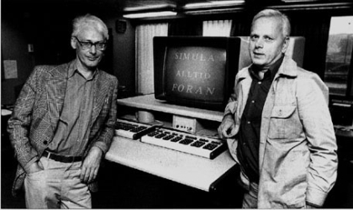
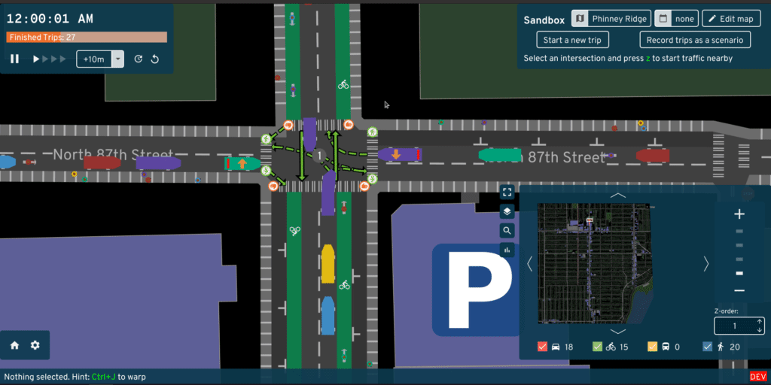
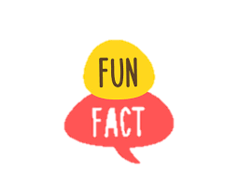
OOP History: Part 2 – Simula
Enter Norwegian computer scientists Ole-Johan Dahl and Kristen Nygaard.
In 1962, Nygaard and Dahl were building physics simulations for a military laboratory and decided to create a programming language tailored for this purpose: Simula I.
In 1966 they saw Hoare's paper and recognized that the notion of 'classes' and 'objects' would be very useful for modeling entities in a simulation.
Simula I was based on the Algol programming language – a procedural language, which is the predecessor to C++, Java, Python, etc!
Notes:
fun fact

Slide 123


Class Fields and Methods
When would we want to use class-level methods?
Can a class-level method call a traditional instance-level method? What about visa-versa? Why?
Thinking time!
Notes:
We use class-level methods when:
A method only accesses class-level variables and thus doesn't need access to member variables
When we're defining utility functions, e.g., a math class with sqrt(), exp(), etc:
class MathLibrary {
static double sqrt(double x); // doesn't need access to member variables
static double exp(double x); // ditto!
};

Slide 124


Constructors, Initializers, Destructors, and Finalizers
What’s the big picture?
Constructor
A method that initializes a new object of a class before it's used.
Initializer (Block)
One or more blocks of code (without function names!) that initialize member variables before the constructor runs.
Destructor
A method that releases the resources held by an object when the lifetime of the object ends (in languages with manual memory management).
Finalizer
A method that MAY run when an object is garbage collected - it performs non-essential cleanup of the object.

Slide 125

When To Use Interface Inheritance: Best Practices
Use Interface Inheritance under the following circumstances.
When you have a 'can-support' relationship between a class and a group of behaviors.
'The Car class can support washing.'
'The kennel class can support iteration.'
When you have different classes that all need to support related behaviors, but aren't related to the same base class.
Cars and Dogs can both be washed, but aren't related by a common base.
Notes:
Inheritance is the process of defining a new class D (aka, a derived class) by (a) inheriting the implementation of another (base) class B, or (b) inheriting an interface B and adding { code } to support all of its functions.
The implementation of a class includes its methods and their { code }, as well as the fields/member variables that define the object's attributes.
Inheritance is the process of defining a new class D (aka, a derived class) based on a previously-defined class B (aka, a base class)...
Inheritance is also the process of defining a new class C and indicating that it promises to implement all the functions specified in an interface.

Slide 126

Interface Inheritance Pros and Cons
PRO
You can write functions focused on a interface, and have it apply to many different classes.
PRO
A single class can implement multiple interfaces and play different roles
CON
Interface Inheritance doesn't facilitate code reuse

Slide 127
Interface Inheritance
Should an interface be able to inherit from another interface?
If a class indicates that it implements an interface, but doesn't provide implementations for all of the methods in the interface, what happens?
Thinking time!
Notes:
Can an interface inherit from another interface? Yes! As long as the derived interface is a superset of the base interface, you can do this in most/all languages.
If a class does not implement all of the methods in an interface, it becomes an abstract class and cannot be used to instantiate objects. You'd need to define a subclass of that class and implement all of the methods in the interface to use it to instantiate objects.

Slide 128
Academic Robot Says:
Multiple Inheritance and Its Issues
'Think about how momentous this work was!
These are almost all of the major concepts that underlie modern OOP languages!'
Question: Can a class be subclassed (derived) from multiple base classes?
Answer: At least in some languages (like C++), absolutely!
class Phone { public: Phone(string tele_num) { ... }
virtual void dial() { ... }
virtual void hangup() { ... }
};
class Camera { public:
Camera(double resolution) { ... }
virtual void takePhoto() { ... }
virtual void takeVideo() { ... }
};
class SmartPhone: public Phone, public Camera { public:
SmartPhone(string tele_num, double resolution) :
Phone(tele_num), Camera(resolution) { ... }
virtual void dial() override { ... }
virtual void hangup() override { ... }
virtual void takePhoto() override { ... }
virtual void takeVideo() override { ... }
};
Sarcastic Robot Says:
'Hey Carey... so what's the big deal? This works just fine.'
Notes:
https://medium.com/@jnkrtech/abstract-data-types-and-objects-17828bd4abdc
see files on desktop pdf of this page

Slide 129
Python: Procedural, Functional and OOP Influences
Procedural
Python has statements, conditionals, loops, etc.
OOP
Python has classes, inheritance, etc.
Functional
Python has lambdas, higher-order functions, list comprehensions, immutability, etc.

Slide 130
Rapid-Fire Python: Ordered Dictionaries
# Ordered dictionaries in Python
from collections import OrderedDict
grades = OrderedDict()
grades['Phys1A'] = 'B+'
grades['Math32A'] = 'A'
grades['CS32'] = 'C-'
for key, value in grades.items():
print(f'In {key} my grade was {value}')
Python also has an ordered dictionary class, which keep items in the order they were added to the dictionary!
Not alphabetical order.
You can obtain a list of values with the .values() method.
In Phys1A my grade was B+
In Math32A my grade was A
In CS32 my grade was C-

Slide 131

Python: A Dynamically-typed Language
Python is a dynamically-typed language!
Notice that variables have no explicit types!
So, for example, this is a valid python program!
# python code
def add_n_print(x, y):
print(x + y)
def main():
a = 10
b = 20
add_n_print(a, b)
a = 'I <3'
b = 'coding'
add_n_print(a, b)
c = 10
add_n_print(a, c)
And we can call our function with totally different types each time!
We can re-assign variables to different types over time!
Invalid operations (e.g., adding an int and a string) are caught at runtime!

Slide 132
Python: A Dynamically-typed Language
Python is a dynamically-typed language!
We'll learn about this in a few weeks, but let's summarize it this way:
In a dynamically-typed language, type checking takes place as a program runs rather than during compilation.
In most dynamically-typed languages, you don't specify the types of variables, just their names!
And a variable can even refer to more than one type of value during the course of a program.

Slide 133
Inferences: Looping With Counters
Challenge: How do you think "range" is implemented?
Answer: Range is a built-in python class that works sort of like this:
class Range {
public:
Range(int start, int end) {
cur_ = start;
end_ = end;
}
bool done() const
{ return cur_ >= end_; }
int getNext() {
int val = cur_;
++cur_;
return val;
}
private:
int cur_, end_;
};
Thinking time!
def study(hrs):
for h in range(1, hrs):
print(f'I studied {h} hours!')
def party(r):
for h in r:
print(f'I partied {h} hours!')
study(4)
r = range(1,4)
party(r)
Here's a hint!
Notes:
Unlike C++, which uses { brackets } to define blocks, Python uses indentation and blank lines!
Python also does away with semicolons – each line is a separate statement.

Slide 134
Rapid-Fire Python: If Statements
Don't forget the colon!
// If statement in C++
int age;
cout >> "How old are you? ";
cin >> age;
if (age >= 0 && age < 21)
cout << "Only lemonade for you!\n";
else {
cout << "That's a fake ID!!!\n";
cout << "Ok. You may drink beer.\n";
}
# If statement in Python
age = int(input('How old are you? '))
if age >= 0 and age < 21:
print('Only lemonade for you!')
else:
print("That's a fake ID!!!")
print('Ok. You may drink beer.')
No blank line is required between if/else blocks!

Slide 135
Don't forget the colon!
Rapid-Fire Python: Simple Loops
// While loop in C++
int leetcode_solved = 0;
while (leetcode_solved < 500) {
cout << "You're not ready!\n";
++leetcode_solved;
}
cout << "Got baller job at Google!\n";
# While loop in Python
leetcode_solved = 0
while leetcode_solved < 500:
print("You're not ready!\n")
leetcode_solved += 1
print('Got baller job at Google!')
Goes from [0,N).
There's no ++ in Python! ☹
Goes from [A,B).
// For loop in C++
for (int i=0;i<10;++i)
cout << "I like scary movies!\n";
for (int i=5;i<10;++i)
cout << i << "ghosts !\n";
for (int i=10;i>0;i = i - 2)
cout << i << "zombies!\n";
# For loop in Python
for i in range(10):
print('I like scary movies!')
for i in range(5,10):
print(f'{i} ghosts!')
for i in range(10,0,-2):
print(f'{i} zombies!')
Goes from [A,B) stepping by C.

Slide 136
Rapid-Fire Python: Arithmetic Operators
Whole numbers default to integers.
// Arithmetic operators in C++
#include <cmath>
int a, b, c, d, e;
float f;
a = 5;
b = a * 10; // 50
c = pow(2,a); // 32
d = a / 2; // 2
e = a % 2; // 1
f = static_cast<float>(a) / 2; // 2.5
# Arithmetic operators in Python
a = 5
b = a * 10 # 50
c = 2 ** 10 # 32
d = a // 2 # 2
e = a % 2 # 1
f = a / 2 # 2.5 Auto converted to float
Use // on integers to do integer division, and on floats to truncate after the decimal.
All non-division operations maintain the type as integer.
// More arithmetic operators in C++
int a = 10;
a += 5; // 15
a /= 3; // 5
# More arithmetic operators in Python
a = 10
a += 5 # 15
a /= 3 # 5.0
Using regular division always produces a floating-point result – even if you're diving two integers.

Slide 137
Rapid-Fire Python: Bitwise Operators
// Bitwise operators in C++
int a = 3, b = 1, c;
c = a & b; // 1
c = a | b; // 3
c = a ^ b; // 2
c = ~a; // -4
c = a >> 1; // 1
c = a << 1; // 6
# Bitwise operators in Python
a,b = 3,1
c = a & b # 1
c = a | b # 3
c = a ^ b # 2
c = ~a # -4
c = a >> 1 # 1
c = a << 1 # 6
// Bitwise operators in C++
int a = 3, b = 1;
a &= b; // 1
a |= 4; // 5
a ^= 1; // 4
b <<= 1; // 2
# Bitwise operators in Python
a,b = 3,1
a &= b # 1
a |= 4 # 5
a ^= 1 # 4
b <<= 1 # 2

Slide 138
Rapid-Fire Python: Boolean Operators
// Boolean operators in C++
bool t = true, f = false, result;
result = t && f; // and: false
result = t || f; // or: true
result = !t; // not: false
result = t ^ x; // xor: true
# Boolean operators in Python
t, f = True, False
result = t and f
result = t or f
result = not t
result = t != f

Slide 139
Rapid-Fire Python: Strings
// Strings in C++
#include<string>
std::string s = "nerd";
std::string t = "This is a really" \
"long string that spans two lines.";
std::string u = "Carey is a " + s;
cout << s[0]; // n
cout << s.length(); // 4
# Strings in Python
s = 'nerd'
t = """This is a really long string that
spans two lines."""
u = 'Carey is a ' + s
print(s[0]) # n
print(len(s)) # 4
Challenge: What is the type of s[0] in Python?
Thinking time!
It's a string! There is no character type in Python!

Slide 140
Rapid-Fire Python: Strings
# String slicing in Python
alphabet = 'abcdefghijklmnopqrstuvwxyz'
s = alphabet[3:10:2] # 'dfhj'
t = alphabet[5:2:-1] # 'fed'
But there's more!
To extract every n^{th} character between slots [a-b), add a stride:
str[a:b:stride]
00000000001111111111222222
01234567890123456789012345
To slice every n^{th} character in reverse between slots [b,a+1), use a negative stride:
str[b:a:-stride]
Challenge: What is the result of u=alphabet[::5]
And you can leave any of these fields out, e.g.:
str[::stride]
str[a::stride]
str[:b:stride ]
Thinking time!
Take every 5th character from start to end:
afkpuz

Slide 141
Strings are immutable in Python, so this does not change u – it just returns a new string!
Strings: Processing
s = 'I luv Python.'
t = s.split(' ')
print(t)
u = ' Nose hairs need trimming '
v = u.strip()
print(u)
print(v)
truth = 'UCLA is great!'
shout_it = truth.upper()
print(truth)
print(upper)
Challenge: What will the program on the left print?
Thinking time!

Slide 142
1
class Person {
public:
Person(string name) { name_ = name; }
virtual void talk() { cout << "Hi!\n"; }
string getName() const { return name_; }
private:
string name_;
};
class Student: public Person {
public:
Student(string name) : Person(name)
{ units_ = 0; }
virtual void talk() {
cout << "Let's party! Oh... and ";
Person::talk();
}
private:
int units_;
};
class Person:
def __init__(self, name):
self.name = name
def talk(self):
print("Hi!\n")
def get_name(self):
return self.name
class Student(Person):
def __init__(self, name):
super().__init__(name)
self.units = 0
def talk(self):
print("Let's party! Oh... and ")
super().talk();
This looks like a function definition but it's not.
It's just the way we show a Student is inherited from Person.
While we use an initializer list to construct the base class in C++...
Methods are virtual by default in Python – there's no explicit syntax.
In Python, we just explicitly call the superclass's constructor!
To override a method, just re-define it in the derived class.
A method can call its base version via the super() prefix!

Slide 143
Rapid-Fire Python: Lists
# Lists in Python
adjs = ['wild', 'wacky', 'silly', 'goofy']
print(adjs[1]) # wacky
print(adjs[-2]) # 2 from end: silly
carey_adjs = adjs[1:3] # ['wacky','silly']
Python has first-class support for lists!
We can index lists just like strings!
Slicing works for lists just like strings!

Slide 144
Looping Over Lists
# Enumerating lists in Python!
faang = ['facebook', 'amazon', 'apple',
'netflix', 'google']
for c in faang:
print(f'Please hire me, {c}!')
for i, c in enumerate(faang):
print(f'Company #{i} is {c}')
Challenge: What does the following program print?
Thinking time!
Please hire me, facebook!
Please hire me, amazon!
Please hire me, apple!
Please hire me, netflix!
Please hire me, google!
Company #0 is facebook
Company #1 is amazon
Company #2 is apple
Company #3 is netflix
Company #4 is google
Notes:
Unlike C++, which uses { brackets } to define blocks, Python uses indentation and blank lines!
Python also does away with semicolons – each line is a separate statement.

Slide 145
Rapid-Fire Python: Simple I/O
// Simple output in C++
float pi = 3.14159;
int n = 42;
cout << pi << " " << n << endl;
cout << n << " times 2 is " << n*2 << endl;
cout << "PI to 2 decimals is " <<
setprecision(3) << pi; // 3.14
This is called the "string interpolation" or "fstring" approach – its the preferred method in Python.
# Simple output in Python
pi = 3.14159
n = 42
print(f,n) # 3.14159 42\n
print(n, 'times 2 is', 2*n) # or...
print(f'{n} times 2 is {2*n}')
print(f'PI to 2 decimals is {pi:.2f}')
// Simple input in C++
int n;
std::string s;
cout << "Enter an int: ";
cin >> n;
cout << "Enter a string: ";
cin >> s;
# Simple input in Python
# Python's input always returns a string!
# So we need to cast to int explicitly
n = int(input('Enter an int: '))
s = input('Enter a string: ')
Notes:
When designing a language, computer scientists choose one or more approaches for each of these facets.

Slide 146
Functional Influences: Comprehensions
Remember comprehensions from Haskell?
input = [10,11,12,15,17,22,23,5]
doubled_odds = [x*2 | x <- input, x `mod` 2 == 1]
Well, Python has them as well!
And their syntax is pretty close to Haskell's!
input = [10,11,12,15,17,22,23,5]
doubled_odds = [x*2 for x in input if x % 2 == 1]
Here are the general forms:
new_list = [expression for item in iterable-object if condition_is_true]
new_set = {expression for key in iterable-object if condition_is_true]
new_dict = {key_expression:value_expression for key in iterable-object if condition_is_true]
Where iterable-object is typically a container like a list, set, dictionary, tuple, string or a Python range.

Slide 147
Functional Influences: Comprehensions
new_list = [expression for item in iterable-object if condition_is_true]
new_set = {expression for key in iterable-object if condition_is_true]
new_dict = {key_expression:value_expression for key in iterable-object if condition_is_true]
# Generate list of squares for numbers between [3,8)
squares = [x**2 for x in range(3,8)]
s = 'This is a sentence'
# Generate a map from each word to its length for sentence s
word_to_len = {w:len(w) for w in s.split()}
# Generate a set of unique words of > 1 character for sentence s
unique_words = {w for w in s.split() if len(w) > 1}
Python also allows you to embed an if/else in the expression:
# Create list of non-negative values from input list
nums = [10,-3,4,-7,0,6,-1,-5,19]
no_negs = [x if x > 0 else -x for x in nums]

Slide 148
Functional Influences: Comprehensions
Challenge: Describe what each of the following comprehensions compute?
Thinking time!
s = "It's so easy to do cool things in Python!"
result = sum([1 for x in s.split() if len(x) >= 5])
s = 'onomatopoeia'
t = len({c for c in s})
z = len([n for n in range(1000) if '9' in str(n)])

Slide 149
Loops Over Containers
# For loop through a list
fruits = ['apple','tomato','fig']
for fr in fruits:
print(f'I like {fr}')
for i, fr in enumerate(fruits):
print(f"Fruit {i} is {fr}")
for f in sorted(fruits):
print(f)
# For loop through a tuple
fruits = ('apple','tomato','fig')
for fr in fruits:
print("I like " + fr)
for i, fr in enumerate(fruits):
print(f"Fruit {i} is {fr}")
for f in sorted(fruits):
print(f)
I like apple
I like tomato
I like fig
I like apple
I like tomato
I like fig
Fruit 0 is apple
Fruit 1 is tomato
Fruit 2 is fig
Fruit 0 is apple
Fruit 1 is tomato
Fruit 2 is fig
apple
fig
tomato
apple
fig
tomato

Slide 150
Loops Over Containers
# For loop through a set
fruits = {'apple','tomato','fig'}
for fr in fruits: # not ordered!!
print(f'I like {fr}')
for i, fr in enumerate(fruits):
print('Fruit {i} is {fr}')
for f in sorted(fruits):
print(f)
# For loop through a dictionary
grades = {'cs32':'B', 'cs33':'C-', 'cs131':'A'}
for k in grades: # only enumerates keys!
print(k)
for i, k in enumerate(grades): # index & key
print(f'Slot {i} holds key {k}')
for k in sorted(grades): # sorted keys only
print(k)
for k, v in grades.items(): # keys & values
print(f'{k} maps to {v}')
Notice that this just enumerates the keys, not the values.
I like apple
I like tomato
I like fig
Fruit 0 is apple
Fruit 1 is tomato
Fruit 2 is fig
cs33
cs32
cs131
cs131
cs32
cs33
apple
fig
tomato
Slot 0 holds key cs33
Slot 1 holds key cs32
Slot 2 holds key cs131
cs33 maps to C-
cs32 maps to A
cs131 maps tos A

Slide 151
Zipping
The output is NOT a list, but an "iterable" bunch of items. We can convert it to a list.
Defer to homework?
Zip pairs each item from the first list with the respective item in the second list.
x = [ 1, 2, 3 ]
y = ['a', 'b', 'c', 'd']
z = list(zip(x,y))
print(z)
names = ['Carey', 'Jen', 'Ignacio', 'Sally']
hobbies = ['climbing', 'tennis', 'writing']
for t in zip(names, hobbies):
print(f'{t[0]} enjoys {t[1]}')
If the lists have different numbers of items, the minimum length is used.
Challenge: Based on the program and output shown to the left, what does Python's zip command do?
Challenge: What happens if the lists are of different lengths?
[(1,'a'),(2,'b'),(3,'c')]
Carey enjoys climbing
Jen enjoys tennis
Ignacio enjoys writing
Each pair is placed in a tuple, and outputted.
Thinking time!
Notes:
Zip pseudocode:
def zip(x,y):
n = min(len(x),len(y))
output = []
for i in range(n):
pair = (x[i],y[i])
output.append(pair)
return output

Slide 152
Functional Influences: Comprehensions
This counts the number of positive integers in the nums list.
nums = [10,-3,4,-7,0,6,-1,-5,19]
t = sum([1 for x in nums if x > 0])
print(t)
u = 'onomatopoeia'
v = len({c for c in u})
print(v)
nums = [-2,-1,0,1,2,3]
w = [x if x > 0 else -x for x in nums]
print(w)
This counts the number of unique characters in the u string using a set.
Challenge: What does the following program print?
This converts a list of numbers to a list of their absolute values.
Thinking time!
4
8
[-2,-1,0,1,2,3]

Slide 153
Functional Influences: Lambdas
Python has a super-simple form of lambdas (anonymous functions)!
Each lambda's body is a single expression (e.g., x+5) on a single line and may refer to the lambda's parameters or variables from the current scope.
The lambda returns the value of the expression – no "return" statement is needed.
The captured variable is now available when the lambda function runs!
The insult function takes a name and a function f as its parameter and calls f() on the name!
This lambda accepts a single parameter, e.g., a person's name.
Function f must take a single argument.
And returns the parameter concatenated with an insult.
Let's pass in a lambda that can insult a person by saying they have earwax.
who
This lambda captures the lang variable from the enclosing scope!
'Jo'
Notice there's no explicit return statement – it's implicit!
'Javascript'
f
f
p
def insult(who, f):
print("It's true: " + f(who))
def main():
insult('Jo', lambda p: p + ' has earwax')
lang = 'javascript'
insult('Jo', lambda p: p + ' codes in ' + lang)
lambda p:
p + ' has earwax'
lang
lambda p:
p + ' codes in' + lang
p
lang
'Jo has earwax'
'Jo codes in javascript'
It's true: Jo has earwax
It's true: Jo codes in javascript

Slide 154
Variable Scoping
Assuming we call what_am_i_doing() and how_im_feeling() from the main function, will either or both functions work?
Python lets you specify default values for parameters!
Thinking time!
def what_im_doing(feeling_lazy):
if feeling_lazy:
activity = "be a slacker"
else:
print("I'm going to study for CS131!")
print(f"Today I'm going to {activity}.")
def how_im_feelin(emotion2):
print(f"I'm feeling {emotion1} and {emotion2}")
def main():
what_im_doing(True)
emotion1 = 'silly'
how_im_feelin('excited')
Top of the morning to you
25
30
Happy birthday, my friend!
Happy weekend, Sachi!

Slide 155
The Zen of Python
python3
climberkip$
Challenge: What happens when you type "import this" in the Python shell?
>>>
import this
The Zen of Python, by Tim Peters
Beautiful is better than ugly.
Explicit is better than implicit.
Simple is better than complex.
Complex is better than complicated.
Flat is better than nested.
Sparse is better than dense.
Readability counts.
Special cases aren't special enough to break the rules.
Although practicality beats purity.
Errors should never pass silently.
Unless explicitly silenced.
In the face of ambiguity, refuse the temptation to guess.
There should be one-- and preferably only one --obvious way to do it.
Although that way may not be obvious at first unless you're Dutch.
Now is better than never.
Although never is often better than *right* now.
If the implementation is hard to explain, it's a bad idea.
If the implementation is easy to explain, it may be a good idea.
Namespaces are one honking great idea -- let's do more of those!
Python prints its design principles!
As we study the language, keep these principles in mind.
They can help you understand why the Python designers made certain decisions.

Slide 156
Code Formatting
Challenge: How is Python code formatting different than C++?
Thinking time!
There is no delimiter character (e.g., semicolon) to indicate the end of a statement!
Blocks are defined by a colon/indentation.
def hello():
print('Greetings!')
def bye(be_nice):
if be_nice:
print('Pleasure to meet you!')
print('I hope we can meet again.')
else:
print('Later loser...')
print("I'm off")
If you de-indent, that ends the previous block.
There is no block delimeter (e.g., { bracers }) to indicate the end of a block or function!
Notes:
Unlike C++, which uses { brackets } to define blocks, Python uses indentation and blank lines!
Python also does away with semicolons – each line is a separate statement.

Slide 157
In python, we declare constants with ALL CAPS.
Technically they're not constants (they can be reassigned!!), but that's the best Python has to offer!
Even More Variables and Types
Python supports "big ints" which can hold any sized integer!
What do these programs print? Why?
THRESHOLD = 1000000000
big = 2**200 # exponentiation
if big > THRESHOLD:
print(f'{big} is really big!')
Thinking time!
1606938044258990275541962092341162602522202993782792835301376 is really big!
Python's / operator always produces a double result (e.g., 2.5)
kittens = 5 / 2 # division
puppies = 5 // 2 # division
if kittens > puppies:
print('Kittens are cuter!')
print(f'{kittens} {puppies}')
Kittens are cuter!
2.5 2
Python's // operator always produces an integer result (e.g., 2)
Notes:
Arbitrary precision integers are implemented as a dynamic array of 32-bit integers, where each integer holds what's called a digit. The digit isn't a base-10 digit like a value from 0-9, but a base-2^30 digit, e.g., a value between and 0 and 2^30. The array can grow to any size. Operations like addition can add each "digit" just like you learned in grade school. But operations like multiplication use more advanced algorithms to speed up the operations from N^2 to n*log(n).

Slide 158
Duck Typing
In Python, you may add a method named __str__ to any class to print out a human-readable description...
Can you think of any practical uses of duck typing?
Thinking time!
class Duck:
...
def __str__(self):
return "I'm a duck with " + \
str(self.feathers) + " feathers."
class Vehicle:
...
def __str__(self):
return "I'm a vehicle with " + \
str(self.hp) + " horsepower."
daffy = Duck(1000)
print(daffy)
outback = Vehicle(210)
print(outback)
Enabling classes to provide a description of themselves in a generic way.
Enabling objects support comparison against other objects in a generic way.
Enabling container objects to be iterated over in a generic way.
When you use print() on such an object, Python will automatically call the object's __str__ function!
I'm a duck with 1000 feathers.
I'm a vehicle with 210 horsepower.

Slide 159
Strings
Python provides lots of cool ways to process strings! Here are a few.
The "a in b" command returns true if a is a substring of b.
There's also "a not in b"!
Challenge: What will the program on the left print?
The strip command returns a new string with whitespace removed from the front/end of the string!
# String slicing in Python
truth = ' UCLA students are awesome! '
if 'awesome' in truth:
print("Yup, they're awesome!")
stripped = truth.strip()
print(stripped)
upper = stripped.upper() # also v.lower()
print(upper)
words = stripped.split(' ')
print(words)
Thinking time!
The upper command returns a new string that's upper-cased.
truth
' UCLA students are awesome! '
The split command returns a list of all the tokens in a string, broken up by the specified delimiter (e.g., ' ')
stripped
'UCLA students are awesome!'
upper
'UCLA STUDENTS ARE AWESOME!'
words
['UCLA',students','are','awesome!']
Yup, they're awesome!
UCLA students are awesome!
UCLA STUDENTS ARE AWESOME!
['UCLA','students','are','awesome!']

Slide 160
Lists
Our stuff variable is an object reference that points at our list object!
Like strings, lists are objects in Python – and they support the same operations as strings!
But... unlike strings, lists are mutable!
["It's", 4, 'real', 'USC students', 'are', 'subpar']
Lists can hold multiple different types of values!
[42, False, 'USC students']
["It's", 4, 'real', 'USC students']
["It's", 4, 'real', 'USC students', 'are']
[42, False, 'walnuts']
stuff
This command mutates the current list object's third element!
This command uses slicing to replace the first two items in the list with three new items.
This variable points to successive items in the list as the loop runs.
Then points our object reference at the new list object.
stuff = [42, False, 'walnuts']
stuff[2] = 'USC students'
stuff[0:2] = ["It's", 4, 'real']
stuff.append('are') # or stuff += ['are']
stuff = stuff + ['subpar']
print(stuff[3:])
if 'walnuts' not in stuff:
for s in stuff:
print(s)
Challenge: What will this program print?
We can also search for items with:
a in b, or a not in b
We can append items onto the end of a list.
Or use stuff.pop() to remove and return the last item from a list!
We can use slicing to extract parts of a list.
['USC students', 'are', 'subpar']
But watch out! Assignment creates a whole new list object!
Thinking time!
It's
4
real
USC students
are
subpar
Finally, we can loop through the items of a list with a for loop!

Slide 161
Parameter Passing: Keyword Arguments
What do you think the following program prints?
What is the type of kwargs?
kwargs
It's idiomatic to name this parameter kwargs.
Thinking time!
When you define a parameter with two asterisks, this forces arguments to be passed to the function in a dictionary.
kwargs
def chow(**kwargs):
for param, val in kwargs.items():
print(f"For {param} you'll eat {val}")
if 'snack' in kwargs:
print(f"Enjoy your snack of {kwargs['snack']}")
print("It's chow time!")
chow(breakfast='eggs')
print("I'm still hungry!")
chow(lunch='salad', snack = 'nuts', dinner='steak')
It's chow time!
For breakfast you'll eat eggs
I'm still hungry!
For lunch you'll eat salad
For snack you'll eat nuts
For dinner you'll eat steak
Enjoy you snack of nuts
Each parameter name → value is added to a dictionary, and the dictionary is passed to the function.
'breakfast' → 'eggs'
'lunch' → 'salad'
'snack' → 'nuts'
'dinner' → 'steak'

Slide 162
Creating a Module
To import a file foo.py, you use the command:
import foo
Creating your own Python module is as easy as creating a .py file!
Then you can import it and use its classes/functions/constants!
our_shape.py
# Our very own python shape module
class Circle:
def __init__(self, radius):
self.radius = radius
def area(self):
return 3.14 * self.radius**2
class Square:
def __init__(self, side):
self.side = side
def area(self):
return self.side * self.side
def cost(shape, dollar_per_sqft):
return shape.area() * dollar_per_sqft
>>>
import our_shape
>>>
c = our_shape.Circle(1)
>>>
print(f"c's area is {c.area()}")
c's area is 3.14
>>>
amt = our_shape.cost(c,10) # $10/sqft
>>>
print(f'Cost for circle c: ${amt}')
As we just learned, we use the module's name as a prefix.
Cost for circle c: $31.400000000000002

Slide 163
Creating A Larger Program
We create larger Python programs using multiple modules:
our_shape.py
window_shop.py
# Our very own python shape module
class Circle:
def __init__(self, radius):
self.radius = radius
def area(self):
return 3.14 * self.radius**2
class Square:
def __init__(self, side):
self.side = side
def area(self):
return self.side * self.side
def cost(shape, dollar_per_sqft):
return shape.area() * dollar_per_sqft
# Module holding window shop functions
import our_shape
def cost_of_all_windows(shapes, cost_sqft):
total = 0
for s in shapes:
total += our_shape.cost(s, cost_sqft)
return total
...

Slide 164
Difference Between a Module and a Script?
A Python script is a .py file that's run from the command line.
A Python module is a .py file that's imported by another .py file.
How can we tell if a Python file is being used as a module or a script?
Thinking time!
nose.py
import boogers
print('I smell!')
print(f"nose.py’s name is {__name__}.")
python3 nose.py
climberkip$
I am full of snot!
boogers.py's name is boogers.
I smell!
nose.py's name is __main__.
boogers.py
python3
climberkip$
print('I am full of snot!')
print(f"boogers.py's name is {__name__}.")
import nose
>>>
I am full of snot!
boogers.py's name is boogers.
Answer: If you run a .py file from the command line, Python sets __name__ to "__main__" indicating it's a script. Otherwise, Python sets __name__ to the module's name.
I smell!
nose.py's name is nose.

Slide 165
Destructors
Challenge: If Python's garbage collector auto-frees memory for us, when would we need a Python destructor?
Thinking time!
import os
class Downloader:
def __init__(self):
self.tmpfile = open('tmpfile.txt', 'w')
def write_to_tmp(self, data):
self.tmpfile.write(data)
def delete_temp_file(self):
self.tmpfile.close() # closes file
os.remove(self.tmpfile.name) # deletes file
d = Downloader()
d.write_to_tmp('some downloaded data\n')
d.write_to_tmp('more downloaded data\n')
d.delete_temp_file()
import os
class Downloader:
def __init__(self):
self.tmpfile = open('tmpfile.txt', 'w')
def write_to_tmp(self, data):
self.tmpfile.write(data)
def __del__(self):
self.tmpfile.close() # closes file
os.remove(self.tmpfile.name) # deletes file
d = Downloader()
d.write_to_tmp('some downloaded data\n')
d.write_to_tmp('more downloaded data\n')
Answer: To free a system resource (like a temporary disk file) that's not managed by the garbage collector
In this case, the destructor must manually free the resource...
Files created on your hard drive are not auto-deleted by the garbage collector.
But, since there's no guarantee a destructor will run in a timely fashion (or EVER)...
in these cases, it's best to define your own tear-down method and then explicitly call it!

Slide 166
class PersonInDuckSuit:
... # code omitted for clarity
def quack(self):
print('Hi! Err... oops, I mean quack quack.')
class Duck:
... # code omitted for clarity
def quack(self):
print('Quack quack quack!')
class Vehicle:
... # code omitted for clarity
def drive(self):
print('Vrooooom!')
Duck Typing
If so, the quack() method is called.
Consider the following three classes and the code below which uses them.
What does this program print?
If an object doesn't have a quack() method, Python generates an error.
Thinking time!
def quack_please(x):
x.quack()
p = PersonInDuckSuit()
d = Duck()
v = Vehicle()
quack_please(p)
quack_please(d)
quack_please(v)
When this line of code runs, Python checks if the object referred to by x has a quack() method...
Hi! Err... oops, I mean quack quack.
Quack quack quack!
AttributeError: 'Vehicle' object has no attribute 'quack'
This is called "duck typing" – in Python, if an object has the requested method, a call to it will just work.
"If it quacks like a duck, then it must be a duck."

Slide 167
Functional Influences: Map
Python's map function takes two inputs:
A function f() that accepts a single argument and returns f(arg).
An iterable object of items – like a list, set, dictionary, etc...
The map function returns a result object where f() has been applied to each of the original items.
def square(n):
return n * n
To extract the results, you can either iterate over the items in the result object...
nums = [2, 3, 5]
results =
Or you can convert the results into a list/set.
results = map(lambda n: n*n, nums)
results = map(square, nums)
square
nums
square_nums = list(results)
# [4, 9, 25]
for sq in results:
print(sq)
You can also pass in a lambda if you like!
# Prints 4, 9, 25
Notes:
Here's the pseudocode for map:
class Mapper:
def __init__(self, f, lst):
self.f = f
self.lst = lst
self.pos = 0
def any_more(self):
return self.pos < len(self.lst)
def get_next(self):
result = self.f(self.lst[self.pos])
self.pos += 1
return result
def map(f, lst):
return Mapper(f, lst)

Slide 168
Functional Influences: Filter
Python's filter function also takes two inputs:
A predicate function f() that accepts a single argument and returns True/False.
An iterable object of items – like a list, set, dictionary, etc...
The filter function returns a result object that includes all original items for which f() returned True.
def is_even(n):
return n % 2 == 0
To extract the results, you can either iterate over the items in the result object...
nums = [2, 3, 4, 5, 6]
results = filter(lambda n: n % 2 == 0,
nums)
Or you can convert the results into a list/set.
results =
results = filter(square , nums)
is_even
nums
even_nums = list(results)
# [2, 4, 6]
for n in results:
print(n)
You can also pass in a lambda if you like!
# Prints 2, 4, 6

Slide 169
Functional Influences: Reduce
Python's reduce function takes two or three inputs:
A function f(accum, item) that accepts two arguments and returns a new accumulated value.
An iterable object of items – like a list, set, dictionary, etc...
An optional starting accumulated value, usually zero, an empty string, or an empty list.
The reduce function returns a single result that is the final accumulated value.
from functools import reduce
def reduce(f, lst, initial):
accum = initial
for item in lst:
accum = f(accum, item)
return accum
def concat(accum, item):
return accum + ' ' + item
To use the reduce method, you must import the functools module!
adjs = ['nerdy', 'geeky', 'silly']
result =
result = reduce(lambda x, y: y + ' ' + x, adjs)
concat
adjs
'Carey is:'
results = reduce(square , nums, )
Challenge: What does the program print?
This is essentially how the reduce function works...
print(result)
Of course, we can pass in a lambda function too!
# silly geeky nerdy
Thinking time!

